Slide 1

Module Four
Communicating Using
Your Device

Slide 2

Today’s Agenda
Module Four | Communicating Using Your Device
Password Refresher — 15 mins
Comparing Emails & Messaging — 20 mins
Break — 5 mins
Introduction to Gmail — 20 mins
Let’s Practice: Writing & Sending an Email — 20 mins
Let’s Practice: Spotting Spam Using the SORRY Method — 20 mins
Wrap-up and Reflection — 10 mins

Slide 3
Group Guidelines
Module Four | Communicating Using Your Device
• Be respectful of each other and everyone’s privacy
• Be kind and supportive, including taking turns talking and listening
• Be mindful of time and shared space
• Unless asked, try not to offer advice
• Participate in the way that works best for you
• Respect devices and materials
Have fun — we’re all learning together!

Slide 4


Today’s Goals
Module Four | Communicating Using Your Device
Today, we are going to
learn about all things email!
We will be covering:
What email is and when to communicate through email
How to send and reply to emails
How to identify suspicious emails

Slide 5
Remember Last Week?
Module Four | Communicating Using Your Device
Last week, we learned about the SORRY Method to spot scams. We also briefly talked about passwords,
and you took home a Password Toolkit.
This week, you’ll put those skills to work!

Slide 6


Passwords
Remember Last Week?
Module Four | Communicating Using Your Device
Email is where passwords and
safety skills come together!
Online Safety
Notes:
Today we're using practice accounts so you can learn how email works. In office hours, we'll help you create your own personal email with a password you choose.

Slide 7
Password Refresher | Why They Matter
Module Four | Communicating Using Your Device
A strong password:
Is at least 10-12 characters long
Uses a combo of letters, numbers,
and symbols (@, !, %)
Is not: your name, birthday, pet name,
or common strings (ABCD123)
Is: different for important accounts
(banking, email)
Your password is the key to your digital front door.

Slide 8
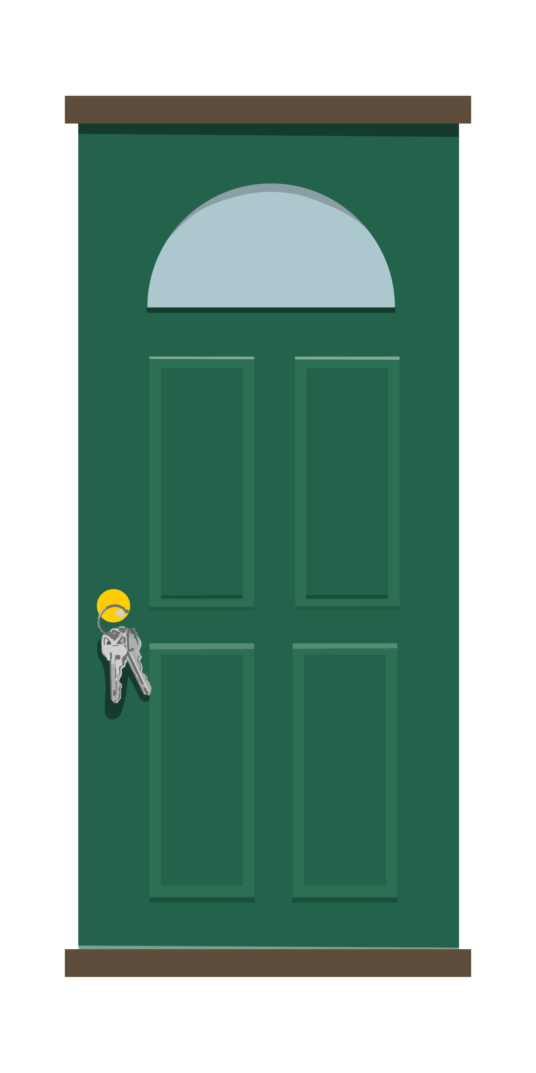
Passwords | The Key to Your Front Door
Module Four | Communicating Using Your Device
We don’t leave our keys
hanging from our front door.

Slide 9
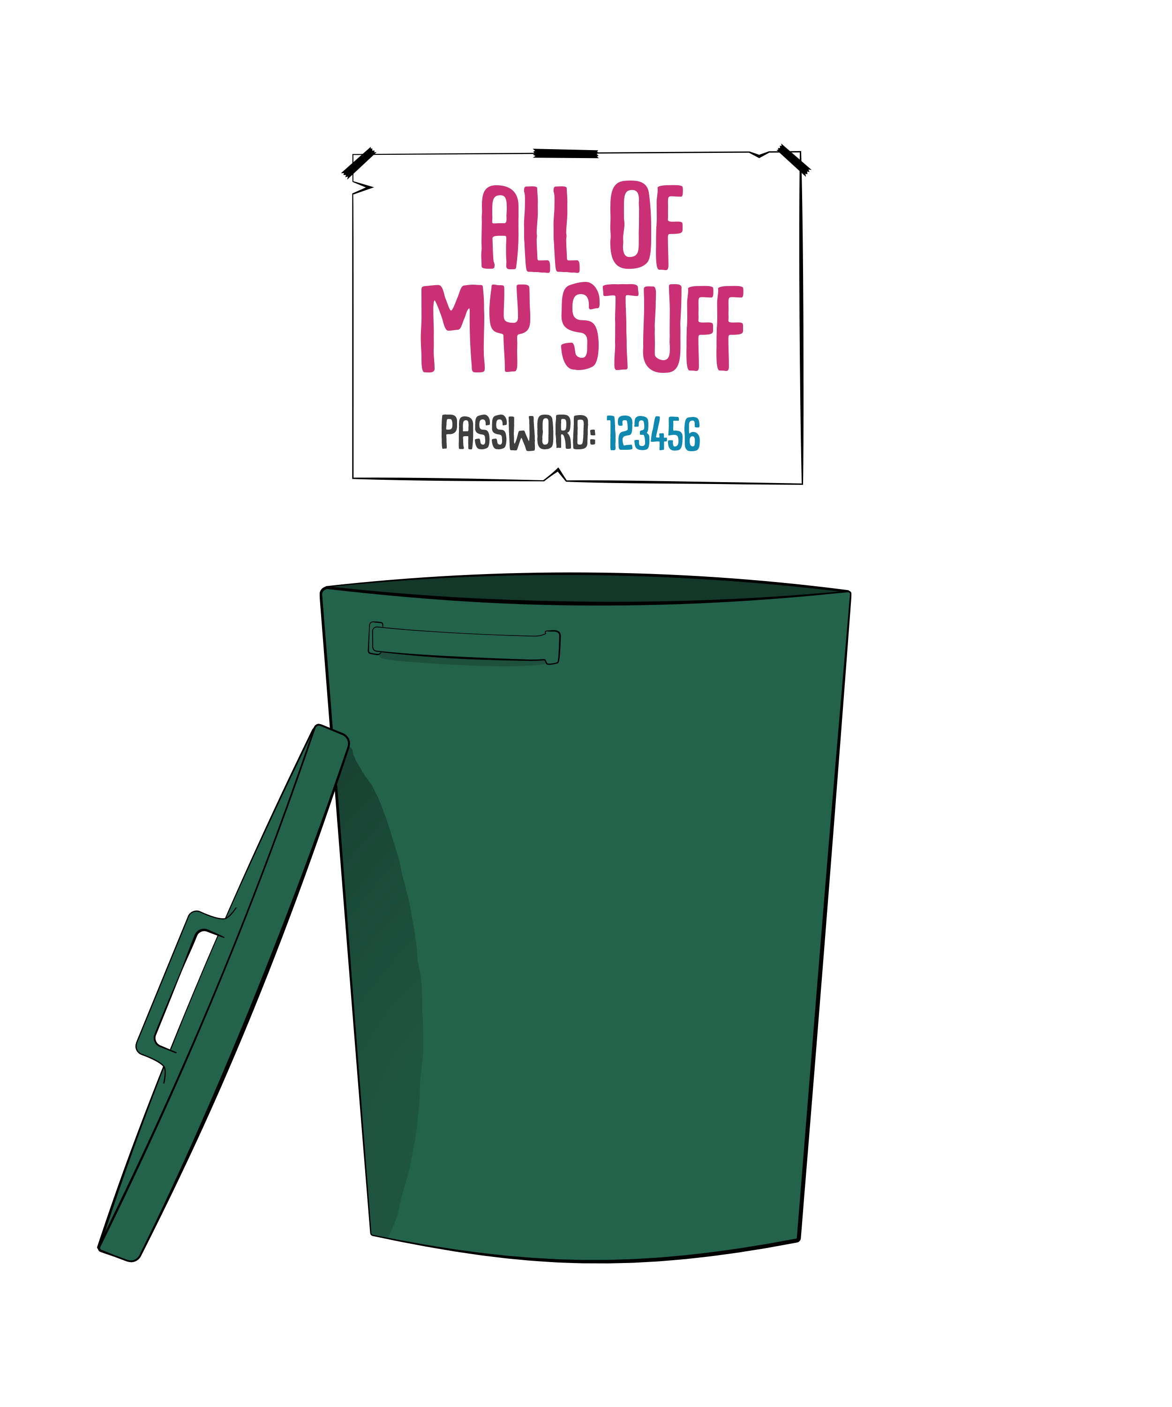

Passwords | Is This a Strong Password?
Module Four | Communicating Using Your Device
1 2 3 4 5 6

Slide 10
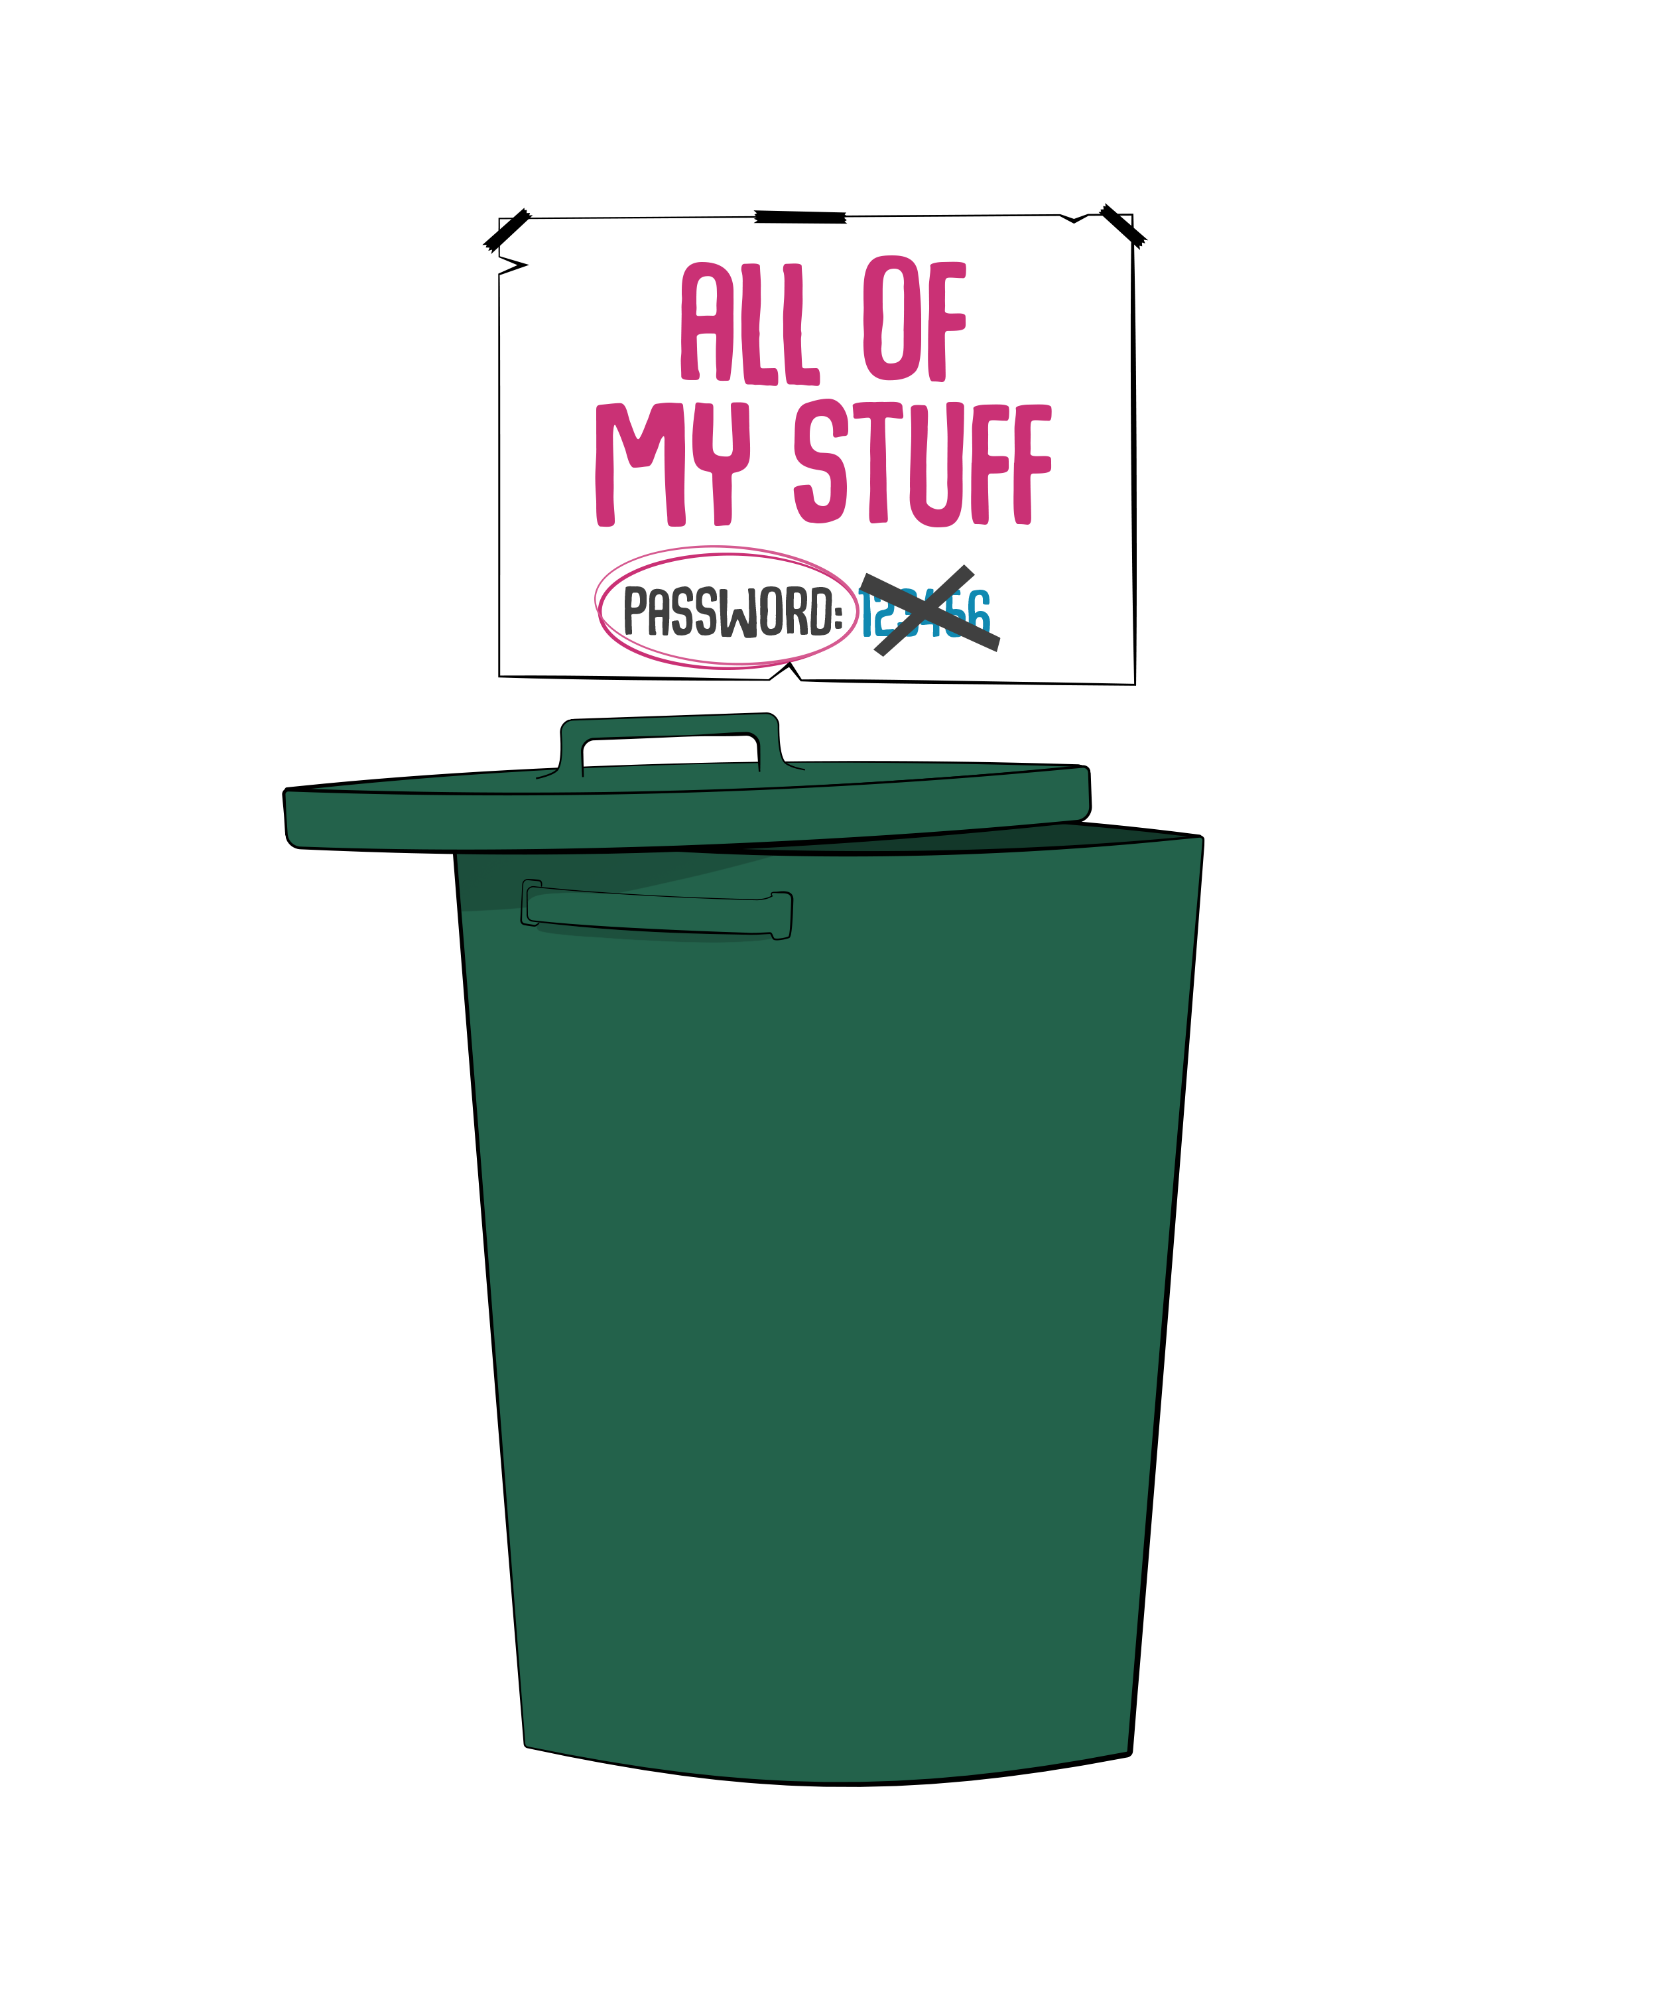
Passwords | Is This a Strong Password?
Module Four | Communicating Using Your Device
password

Slide 11
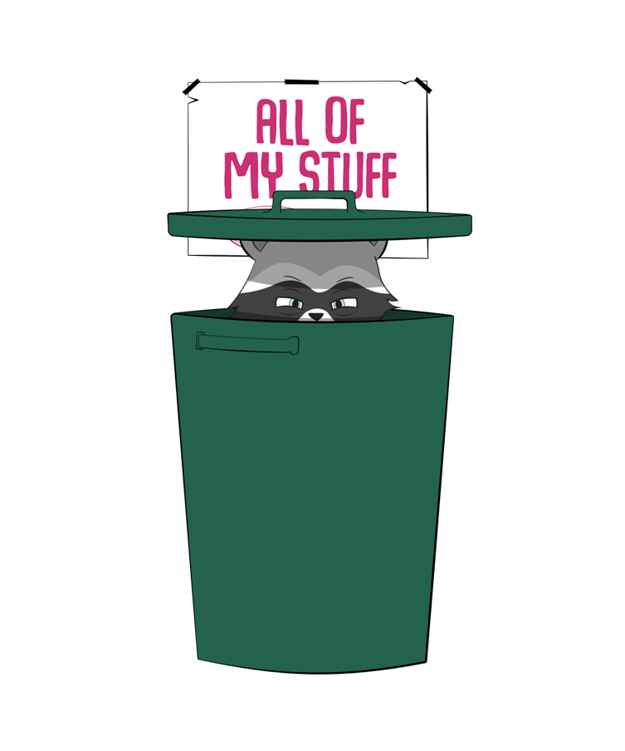
Passwords | Is This a Strong Password?
Module Four | Communicating Using Your Device
p@ssword
Notes:
Better, but still meh.

Slide 12

Passwords | Let’s Get Really Sneaky
Module Four | Communicating Using Your Device
!wGomPcta5tt2
(I won’t give out my password
‘cause that’s a silly thing to do)
Notes:
Now THat’s a Password! (Show how we got from the sentence to the password.)

Slide 13
Passwords | Let’s Get Really Sneaky
Module Four | Communicating Using Your Device
!wGomPcta5tt2
(I won’t GIVE out my PASSWORD
‘cause that’s a SILLY thing to DO)
Notes:
Now THat’s a Password! (Show how we got from the sentence to the password.)

Slide 14


What if I Forget My Password?
Module Four | Communicating Using Your Device
There’s usually a “forgot password” link to click.
You’ll need either the email or phone number you used to create the account.
The website will send an email or text message linking you to a page where you can change your password.
We can practice this
during office hours!

Slide 15
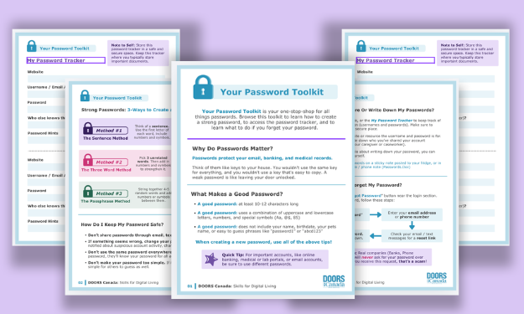
The Password Toolkit
Module Four | Communicating Using Your Device
When in doubt, reference the Password Toolkit for tips and tricks on all things passwords

Slide 16


Email vs. Text Messaging
Module Four | Communicating Using Your Device
Email
Text Messaging
Can be sent by Wi-Fi or through cellular data
Used for longer messages
(rescheduling an appointment with Dr. Bob)
More formal tone: “How are you doing today?”
Can be sent using cellular data only
(requires a SIM card)
Used for shorter messages that require a faster response: “What’s for dinner?”
More casual tone: “What’s up?”
Notes:
We’ll be concentrating on email today but can answer messaging questions during office hours.

Slide 17

Let’s Practice:
Practice Gmail Accounts
You each have a Practice Gmail Account set up on your tablet.
  doorsstudent1@gmail.com
  doorsstudent2@gmail.com
  doorsstudent3@gmail.com
  doorsstudent4@gmail.com
The number on the back of your tablet is your practice address.

Slide 18
Let’s Practice:
Gmail Tour
Let’s explore your inbox together!
Everyone follow along on your tablet:
Find the Gmail app, and open Gmail
Click on the welcome email from the DOORS Facilitator email address
Read it together
Click the back arrow to return to your inbox.
Notes:
Instructors go around and make sure everyone is able to open the email and get back to the inbox.

Slide 19
Let’s Practice:
Parts of an Email
Let’s go back to that email in your inbox.
From: Who sent it?
Subject: In brief, what is the email about?
Body: What is the actual message in the email?
Timestamp: When was it sent? (time/date)
These parts appear in every email you receive.

Slide 20
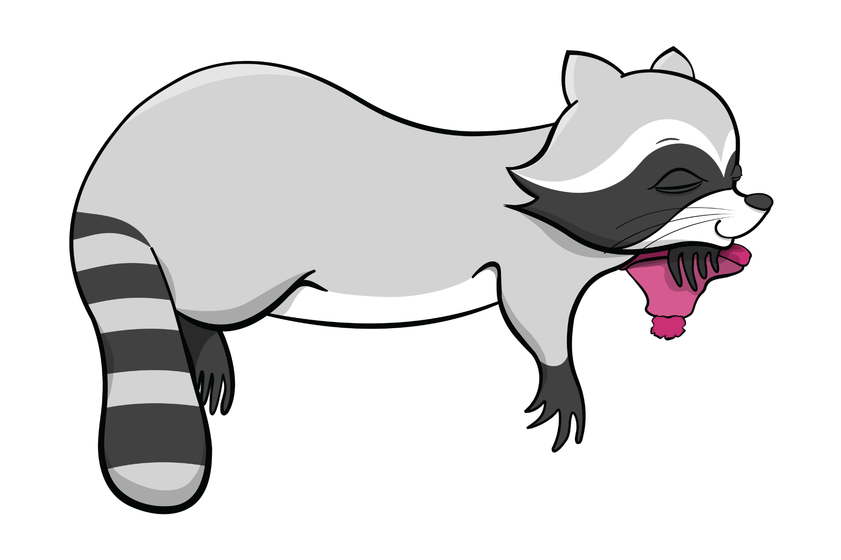

Break
Take 10 minutes to stretch, get water, take care of yourself etc.

Slide 21
Let’s Practice:
Reply to an Email!
Let’s reply to the welcome email!
Everyone follow along on your tablet:
Find the reply button (arrow pointing left)
Tap the reply button
Type your message in the text field
“Hello! This is [insert name] and I am learning email.”
Click the send button (paper airplane or arrow)
Check the sent folder — do you see if your email?

Slide 22


The Difference Between Reply & Reply All
Module Four | Communicating Using Your Device
Reply – responding to only the email address that corresponds to the original sender of the email (one person)
Reply All – responding to all of the email addresses included within the email (multiple people)
Notes:
It’s easy to send an email to a bunch of different people at once. You can send to any email address you have. However, when you reply to an email that was sent to a bunch of people (how would we know that?), we have the choice to reply to just the sender, or to everyone on the email. The button the reply to everyone is called “reply all” and generally looks like this:

Slide 23

Reply or Reply All: Which Should I Use?
Module Four | Communicating Using Your Device
If your boss emails everyone on your work team saying: send me the hours you worked this week, you would use Reply.
You don’t need to send your hours to everyone on your team, just your boss.
Notes:
Talk about how apps are not designed for us

Slide 24
Reply or Reply All: Which Should I Use?
Module Four | Communicating Using Your Device
If someone emails a group of friends saying, what restaurant should we take Emily to for her birthday, click Reply All to respond.
This way, everyone who received the email can read your suggestion.
Notes:
Talk about how apps are not designed for us

Slide 25
Writing a New Email
Module Four | Communicating Using Your Device
Sometimes, you need to start a fresh email, not reply. Here’s how:
Tap Compose (look for the + or pencil icon, usually bottom right)
To: Who are you writing? (their email address)
Subject: What’s this about? (brief description)
Body: Your message
Tap Send (paper airplane icon)
Notes:
Let's try it together.

Slide 26
Let’s Practice:
Writing a New Email
Tap the new email icon
To: your partner’s email (check the whiteboard)
Subject: This is (your name) emailing
Body: I’m emailing from DOORS
Tap Send (paper airplane icon)
Check your inbox — did someone email you?
Notes:
Let’s try it together.

Slide 27


Email Tips
Module Four | Communicating Using Your Device
Read your email before hitting send (check for typos)
Be polite and be clear
Use a subject line that makes sense
You can save as draft if you're not ready to send
Double check the recipient’s email address
is correct before hitting send

Slide 28
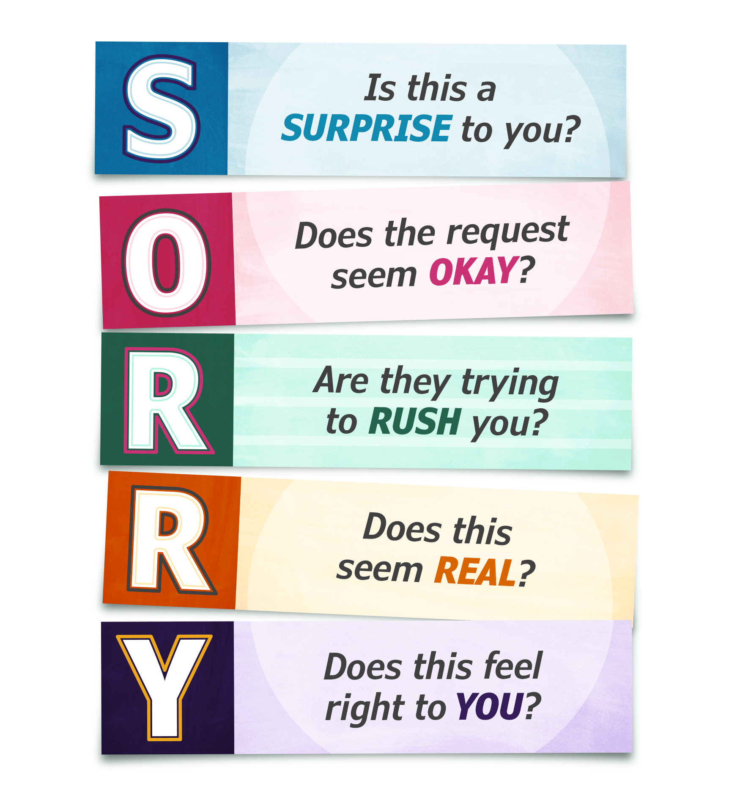
Suspicious Emails & Email Scams
Module Four | Communicating Using Your Device
Now that you know how email works, let’s talk about staying safe.
Scammers love email.
Remember the SORRY Method from last week?

Slide 29

Let’s Practice:
Spotting Suspicious Emails
We’ve handed out some printouts of real emails.
Let’s go through them and use the SORRY Method to decide if they’re safe or if they’re scams.
Notes:
Go through 3- 5 printouts depending on time

Slide 30


What To Do If You Receive a Suspicious Email
Module Four | Communicating Using Your Device
Don’t click anything!
— Don’t reply to the message. —
— Don’t call any phone numbers listed. —
— Don’t download any attachments. —
Delete it or move it to spam.

Slide 31
Think You’ve Been Scammed?
Module Four | Communicating Using Your Device
Don’t panic!
If you gave financial info:
Call your bank immediately – call the phone number on your bank card
Change your passwords
Report it:
Canadian Anti-Fraud Centre: 1-888-495-8501
Tell someone you trust
Getting help quickly is what matters —
Not blame, shame,
or embarrassment.

Slide 32
Today’s Achievements
Module Four | Communicating Using Your Device
Email can feel complicated when you're just starting out.
With the skills you’ve learned today, it doesn’t have to.
Today, you learned:
How to create a strong password
How to navigate Gmail
How to read, reply to, and send emails
How to practice spotting email scams
using the SORRY method
Email is one of the most common ways people stay connected at work and in daily life. Knowing how and when to use it gives you the confidence to communicate clearly and easily.
Notes:
You are a digital citizen! This is a great accomplishment, and I hope you’ll take a minute to be proud of all you’ve done.

Slide 33

Wrap-Up & Reflection
Module Four | Communicating Using Your Device
What is one thing you
feel confident about
with email?
What is one thing you want to practice more?
Who is someone you want to email now
that you have an
email account?

Slide 34
Next Steps
Module Four | Communicating Using Your Device
Keep your SORRY Method Handout and Password Toolkit handy as you continue navigating the online world!
If you would like to sign up for a personal Gmail account, schedule an office hours appointment!
Interested in continuing to build your digital skills?
In May we will launch: DOORS 2 – Skills for Digital Living

Slide 35


That’s a Wrap!
Thank you for joining
DOORS Foundations!

