Slide 1

Module Three
Staying Safe Online

Slide 2

Today’s Agenda
Module Three | Staying Safe Online
Warm-up — 5 mins
The SORRY Method | Scam Detector — 20 mins
Break — 5 mins
Let’s Practice: Scam-0-Rama Game — 20 mins
What to Do If You Encounter a Scam — 10 mins
All About Passwords — 15 mins
Take-Home Activity | Password Toolkit — 5 mins
Wrap-up and Reflection — 10 mins

Slide 3
Group Guidelines
Module Three | Staying Safe Online
• Be respectful of each other and everyone’s privacy
• Be kind and supportive, including taking turns talking and listening
• Be mindful of time and shared space
• Unless asked, try not to offer advice
• Participate in the way that works best for you
• Respect devices and materials
Have fun — we’re all learning together!

Slide 4
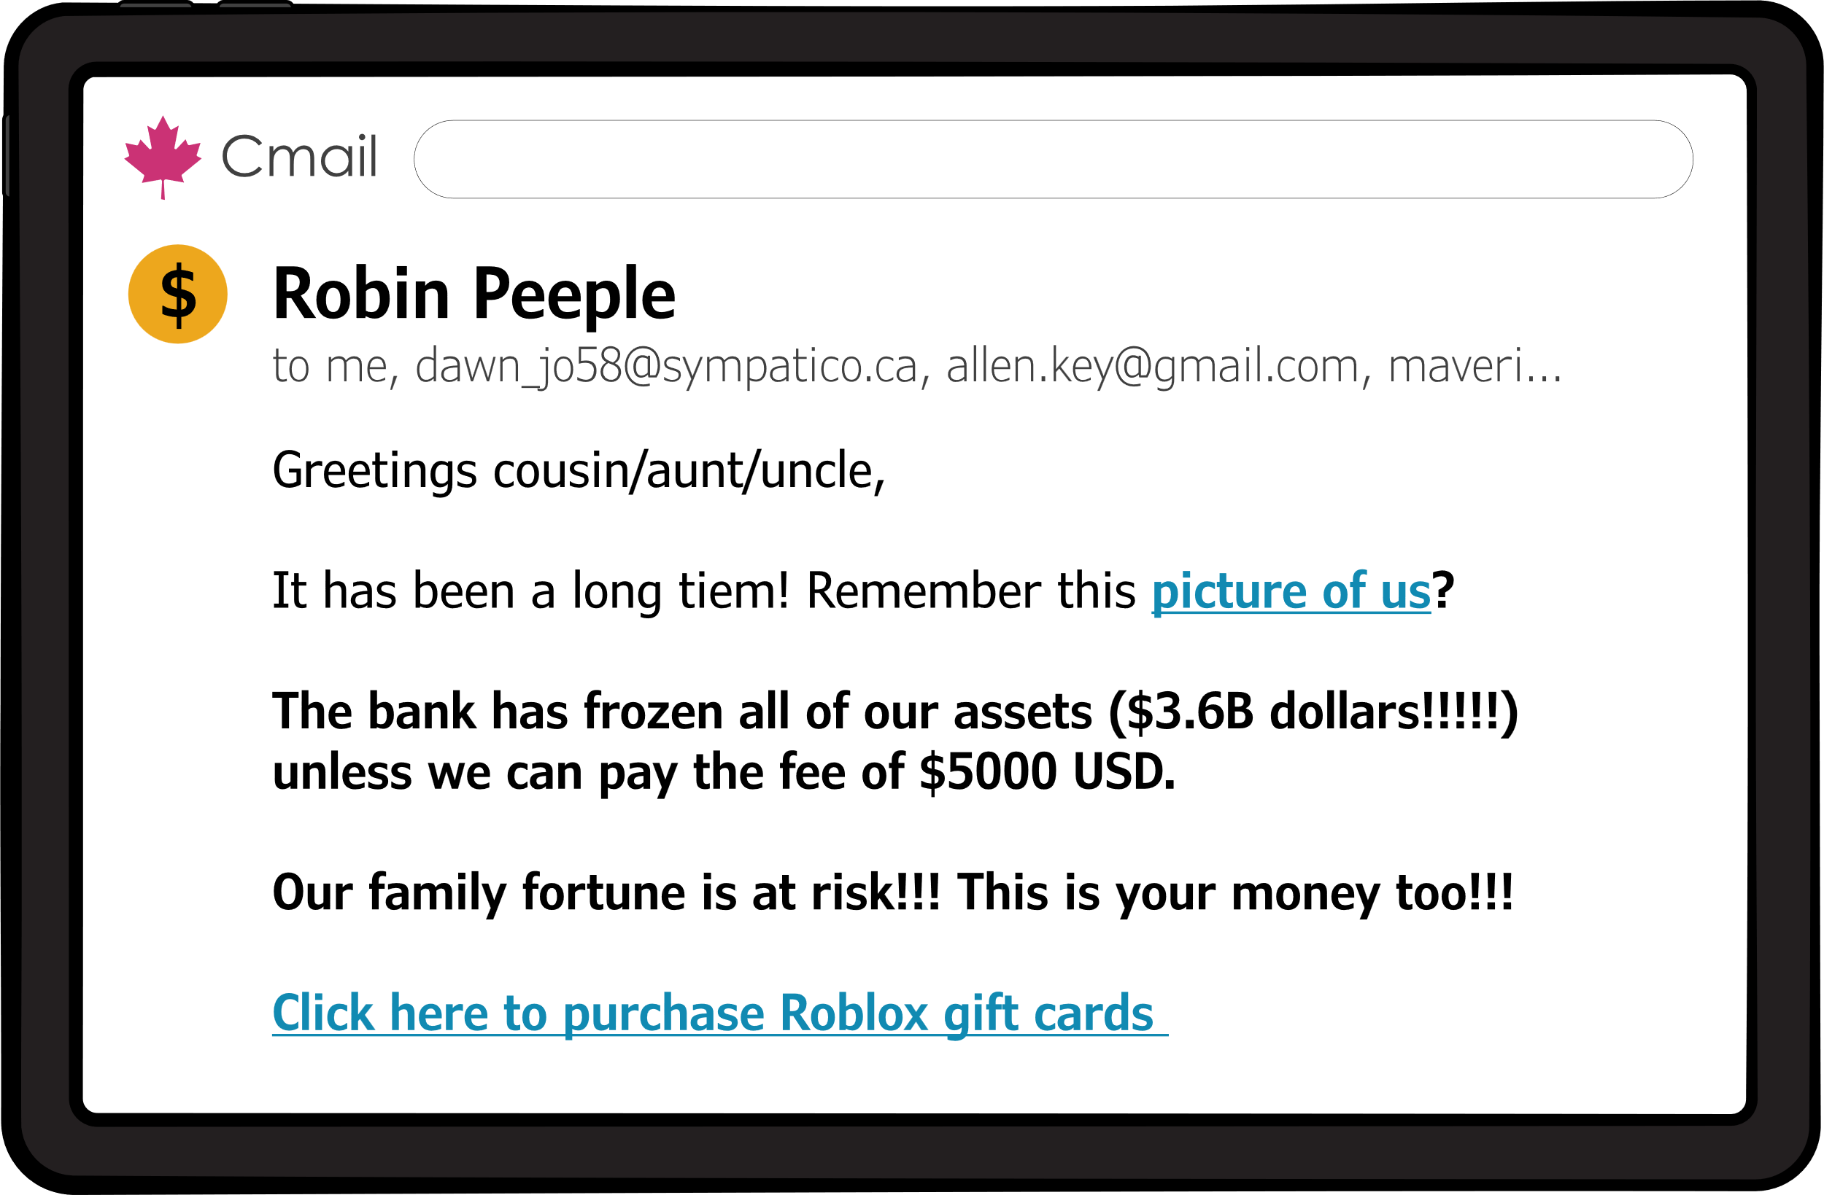

Today’s Goals
Module Three | Staying Safe Online
Today, we are going to
discuss online safety together!
We will be covering:
How to recognize scams
What to do if you come across
a scam
How to create a strong password

Slide 5
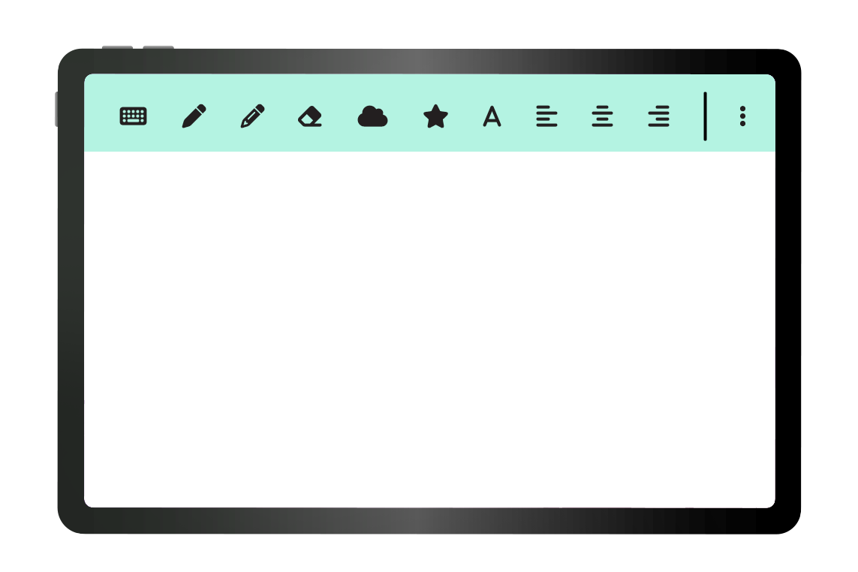
Things to Remember
Module Three | Staying Safe Online
Don't expect perfection – we're all learning together
Take breaks, step away whenever you need to
Questions are always welcome
Learning takes time (and that's okay!)
!
Notes:
Talk about how apps are not designed for us
Facilitator note about hospital codes: You may hear hospital announcements, known as codes, during the session.This can sometimes be distracting, but it is normal in a hospital setting. Your facilitator will let you know if any action is needed. If you need a break or want to talk, just let us know.

Slide 6
Something to Consider
Module Three | Staying Safe Online
When it comes to using the internet,
why do I need to be safe online?
Notes:
Last week, in Module 2, we practiced connecting to wifi and we used the Chrome browser and search page to find information online.
These are super important skills. The internet is full of useful information and activities.

Slide 7

Almost Everyone is Using the Internet
Module Three | Staying Safe Online
The internet is full of a ton of helpful information and activities.
Nearly, everyone uses the internet to support their everyday life.
If you had to guess, how many people
do you think are
using the internet?

Slide 8
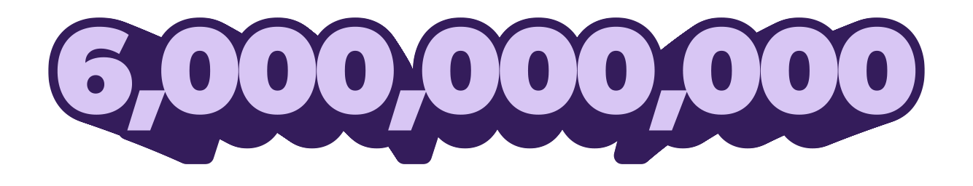
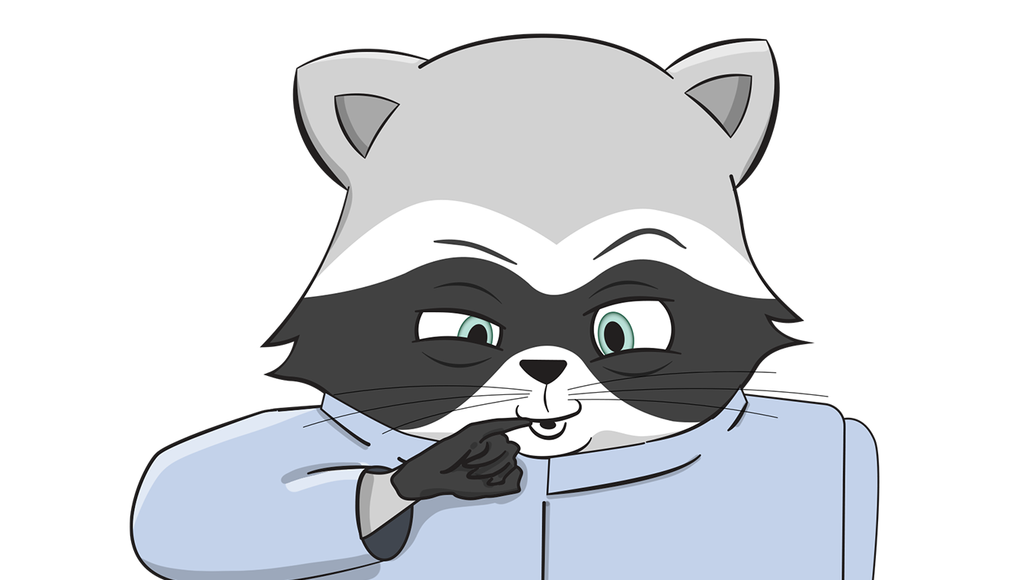
Why Do I Need to Stay Safe Online?
Module Three | Staying Safe Online
Notes:
With that many people,it’s not a surprise that some of them might not be as trustworthy as others. There are people online who will play tricks to try to steal your money or even copy your identity.

Slide 9
Almost Everyone is Using the Internet
Module Three | Staying Safe Online
With the huge amount of people using the internet, this also increases the number of scams and scammers on the internet!
This brings us back to
the importance of online safety!
Notes:
Note: sizing is correct in powerpoint with DOORS body font

Slide 10
What are Scams?
Module Three | Staying Safe Online
Online scams are a form
of internet fraud.
Scammers use the internet to trick people into sharing personal information or sending money.
Notes:
With that many people,,it’s not a surprise that some of them might not be as trustworthy as others. There are people online who will play tricks to try to steal your money or even copy your identity.. We’re talking about:
If you've ever been tricked, it's not because you're gullible.
Content edit: removed “through the internet” for redundancy

Slide 11
The Truth About Scams
Module Three | Staying Safe Online
Scammers are professionals who
fool people for a living.
They know a lot of tricks
that work on a lot of people.
Notes:
If you've ever been tricked, it's not because you're gullible.
Optional content addition

Slide 12

Who Do Scammers Target?
Module Three | Staying Safe Online
But especially:
Scammers
Target
Everyone!
Helpful people
Polite people
Stressed-out people
People who want to believe good news
Notes:
These are just things that make us human. Being a helpful and kind person is awesome. We don’t want to stop being that person, we just need to learn how to look out for the traps that scammers try to set for us.

Slide 13

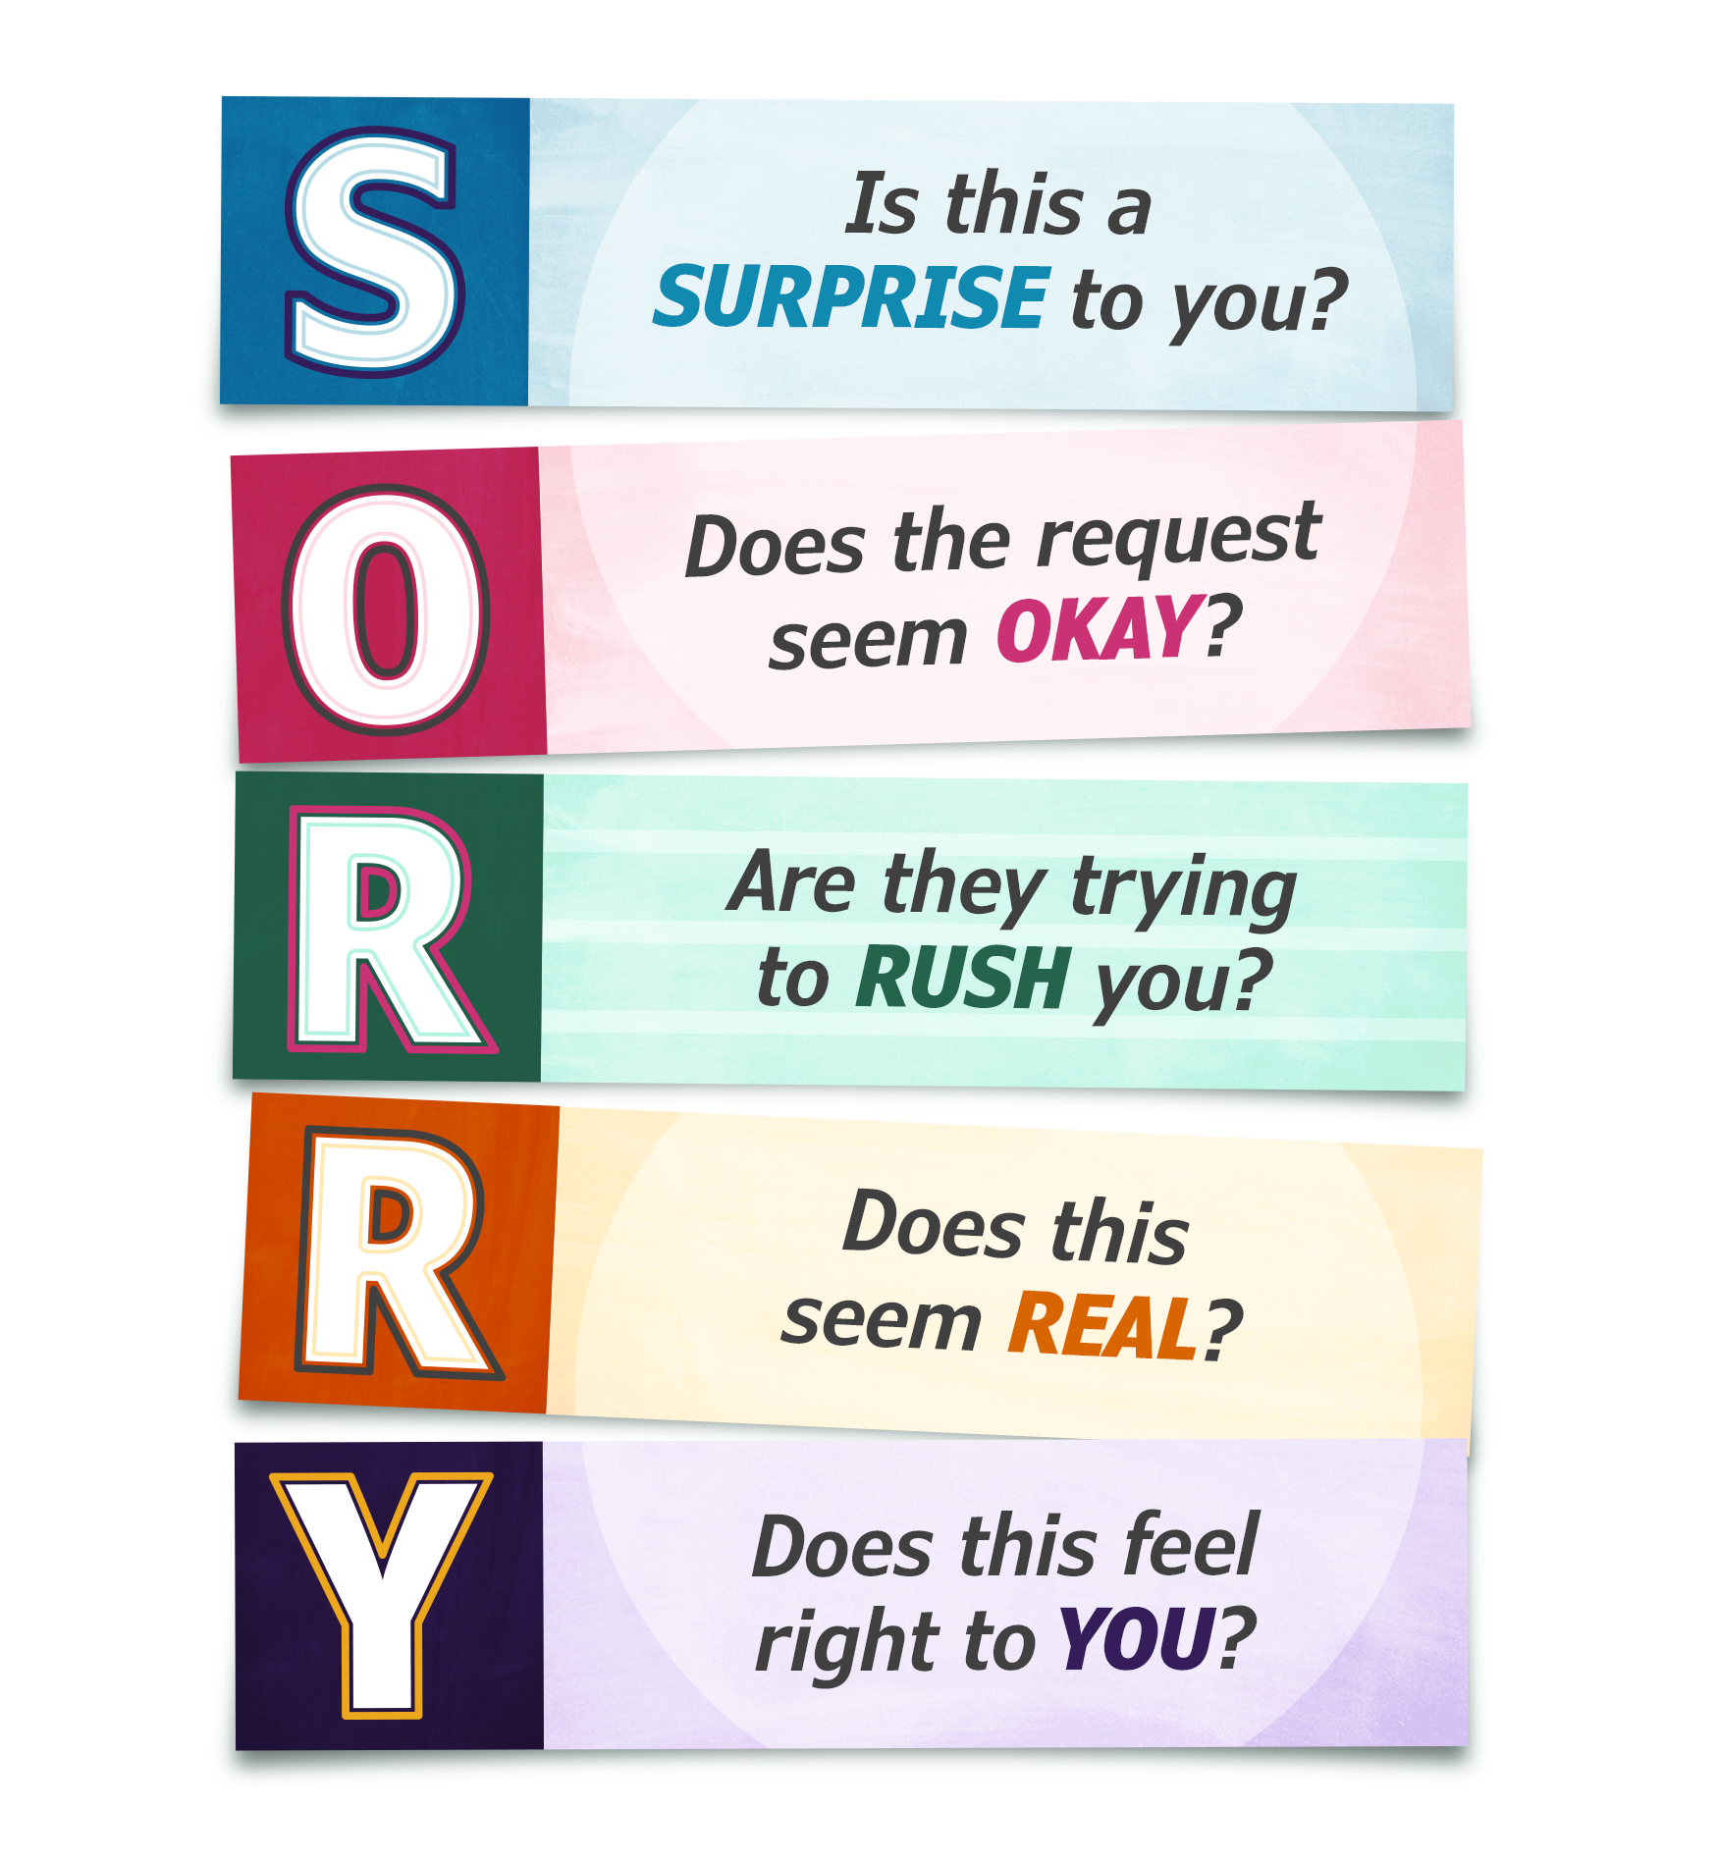
Sorry, scammers.
Not today.
When you come across something on the internet
that feels off, ask yourself
the SORRY questions:
Notes:
This works for emails, texts, calls, pop-ups, everything. We're going to learn each question, then practice using them in a game.

Slide 14


Module Three | Staying Safe Online
Tip:
Most scams rely on
surprising you.
Was I expecting to hear from this person?
Red Flags to look out for:
Prize from a contest you didn't enter
Package delivery you didn't order
Account problem you didn't know about
Friend asking for money out of the blue

Slide 15

Module Three | Staying Safe Online
Tip: Real companies don’t ask for this info out of the blue.
Does this message feel okay?
Red Flags to look out for:
Asking for passwords or personal info
Wanting bank info, gift cards or wire transfers
Requesting remote access to your device
Asking you to keep something secret
Notes:
Asking for passwords or banking info
Wanting gift cards or wire transfers
Requesting remote access to your device
Asking you to keep something secret
Real companies don't ask for passwords, and banks don't take payment in gift cards.

Slide 16

Module Three | Staying Safe Online
Tip: Scammers rush you, so you don’t have time to think.
Do they want me to act right now?
Scam language to look out for:
Act Now! Limited Time!
Your account will be closed!
Claim within 24 hours!
Urgent action required!
Notes:
Scam language:
Act now! Limited time!
Your account will be closed!
Claim within 24 hours!
Urgent action required!
Scammers rush you so you don't have time to think.

Slide 17


Module Three | Staying Safe Online
Tip: Sometimes, scams can be very well written.
If you’re unsure, use all the SORRY questions.
Think like a detective! Look for clues.
Classic clues to watch for:
Email address looks off (amaz0n-h3lp.ca)
Generic greeting (Dear User / Customer)
Too good to be true offers
Links don’t match what they say
Notes:
These are some classic clues that something isn’t right:
Email address looks wrong (amaz0n-support.com)
Generic greeting (Dear Customer, not your name)
Too good to be true offers
Links that don't match what they say
WARNING: AI can now write perfect emails. Don't rely on spelling alone - use all the SORRY questions.

Slide 18


Module Three | Staying Safe Online
Tip: Don’t click anything. Don’t reply. Investigate or ask someone you trust!
What are your instincts telling you?
If something feels…
Too good to be true
Confusing or unclear
Pushy or aggressive
Not relevant to me
Just…off.
Notes:
These are some classic clues that something isn’t right:
Email address looks wrong (amaz0n-support.com)
Generic greeting (Dear Customer, not your name)
Too good to be true offers
Links that don't match what they say
WARNING: AI can now write perfect emails. Don't rely on spelling alone - use all the SORRY questions.

Slide 19
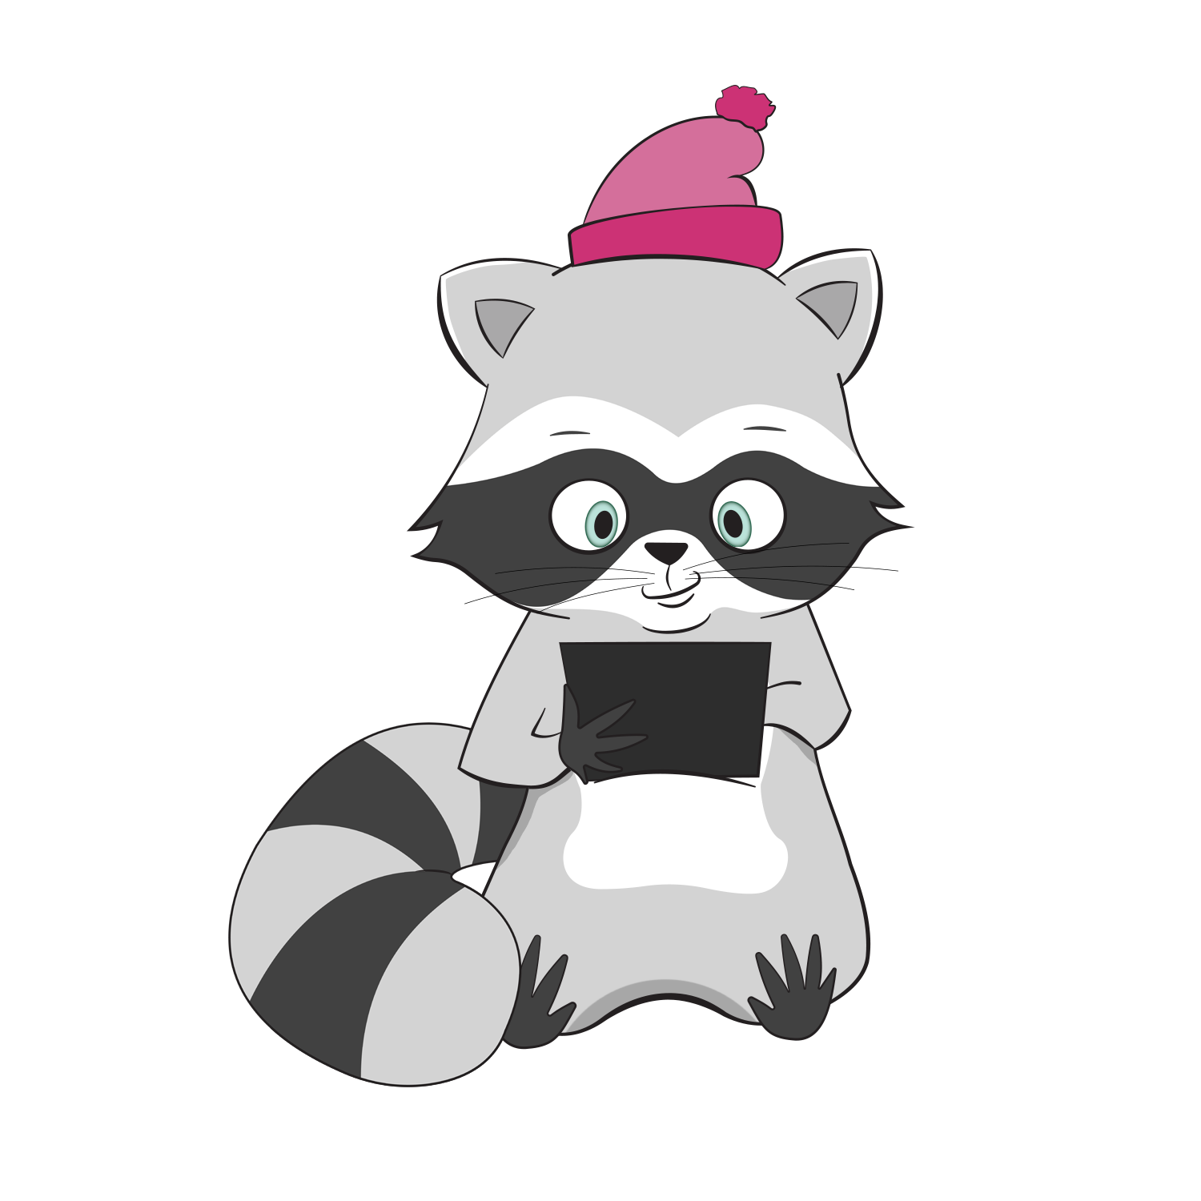
Sorry, scammers.
Not today.

Slide 20
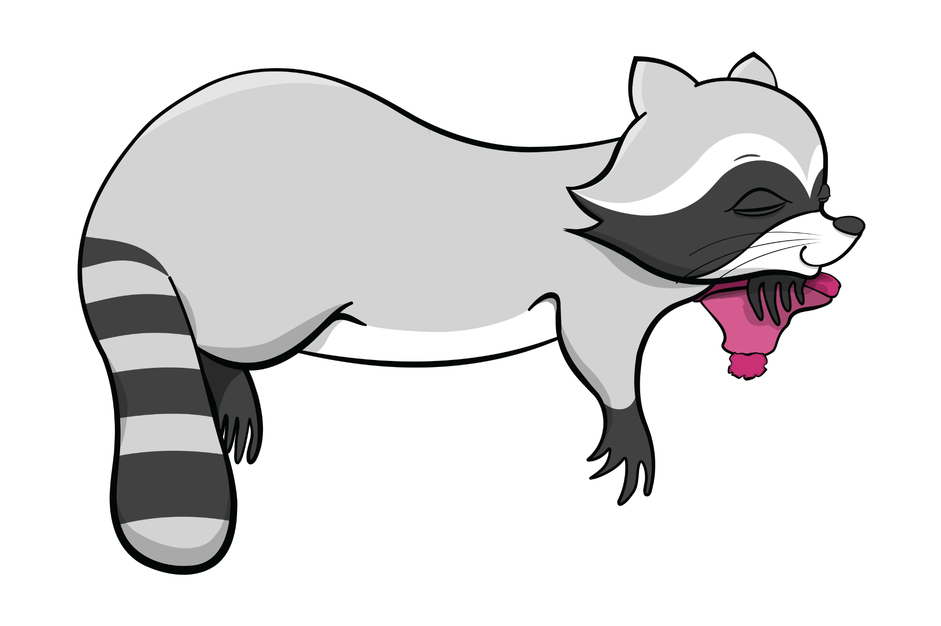

Break
Take 10 minutes to stretch, get water, take care of yourself etc.

Slide 21

Let’s Practice:
Scam-O-Rama
Pull out your tablet, and head on over to the DOORS Skills Lab
Today, we’ll be playing Scam-O-Rama. In this game, you will see real email messages. Some are scams, some are not scams. For each message:
Read it carefully
Use the SORRY method
Decide —
Scam or Not?
Notes:
Circulate and help. After most people finish each example, pause the group and discuss. Don't rush !.

Slide 22
Let’s Practice:
Scam-O-Rama
We will run through a few messages together. After each one, we will discuss the message as a group.
Questions to Consider:
What did you notice?
Which SORRY question
caught it?
Scam or Legitimate?
What would you do?
Notes:
The game will highlight parts of the message in SORRY colors to show you what to look for.

Slide 23


What To Do If You Come Across a Scam
Module Three | Staying Safe Online
Don’t click anything!
— Don’t reply to the message. —
— Don’t call any phone numbers listed. —
— Don’t download any attachments. —
Delete it or move it to spam.

Slide 24
What If You’re Not Sure It’s a Scam?
Module Three | Staying Safe Online
If you’re still unsure if it’s a scam, you can:
Look up the company yourself
(remember the internet searching skills we learned last week)
Put it in your Buddy Folder
Bring it to DOORS office hours
Notes:
We’ll look at buddy folders next week

Slide 25
Think You’ve Been Scammed?
Module Three | Staying Safe Online
Don’t panic!
If you gave financial info:
Call your bank immediately – call the phone number on your bank card
Change your passwords
Report it:
Canadian Anti-Fraud Centre: 1-888-495-8501
Tell someone you trust
Getting help quickly is what matters —
Not blame, shame,
or embarrassment.

Slide 26

All About Passwords: Why They Matter
Module Three | Staying Safe Online
Your password is the key to your digital front door.
A strong password:
Is at least 10-12 characters long
Uses a combo of letters, numbers, and
symbols (@, !, %)
Is not your name, birthday, pet name, or
common strings (ABCD123)
Is different for important accounts (banking, email)
Notes:
When we set up your email account in Office hours we can practice making and changing a password together.

Slide 27
Take-Home Activity:
Password Toolkit
The Password Toolkit includes:
3 methods to create strong passwords
Where to safely write them down
How to reset if you forget
Practice worksheet

Slide 28
Today’s Achievements
Module Three | Staying Safe Online
Today, you learned:
That scams target human decency, not stupidity
How apply the SORRY method to evaluate suspicious messages
How to practice identifying scams with real examples
What to do if something feels wrong or you’re still not sure
Scammers count on people not knowing this stuff.
You're no longer one of them.
Scams are carefully crafted to trick even the most tech-savvy people. Knowing how to spot them — and what to do — puts you firmly in control.
Notes:
That’s a whole lot. Well done everyone! Next week we’re going to finish strong with messages and email!

Slide 29

Wrap-Up & Reflection
Module Three | Staying Safe Online
What is one SORRY question that makes the most sense to me?
What is something that surprised me from the Scam-O-Rama game?
When I think about staying safe online,
how does that
make me feel?

Slide 30

Looking Ahead
Module Four | Communicating Using Your Device
Great work today!
See you on March XX at XX:XX—you’ve got this!
Here is a look ahead at Module 4, where we will learn about:
Communicating via email
Sending an email
Creating your own email
Notes:
That’s a whole lot. Well done everyone! Next week we’re going to finish strong with messages and email!

