Slide 1

Module Two
Navigating the Internet

Slide 2

Today’s Agenda
Module Two | Navigating the Internet
Warm-up — 5 mins
Let’s Practice: Using the Android Keyboard — 15 mins
Understanding Wi-Fi and Data — 20 mins
Let’s Practice: Connecting to CAMH Guest Wi-Fi — 10 mins
Break — 5 mins
Exploring Browsers and Search Engines — 10 mins
Let’s Practice: Searching the Internet — 15 mins
Wrap-up and Reflection — 10 mins

Slide 3
Group Guidelines
Module Two | Navigating the Internet
• Be respectful of each other and everyone’s privacy
• Be kind and supportive, including taking turns talking and listening
• Be mindful of time and shared space
• Unless asked, try not to offer advice
• Participate in the way that works best for you
• Respect devices and materials
Have fun — we’re all learning together!

Slide 4


Today’s Goals
Module Two | Navigating the Internet
Today, we are going to
explore the online world together!
We will be covering how to:
Connect to the internet
Search for what you need
Use the internet in ways that
support your daily life!

Slide 5
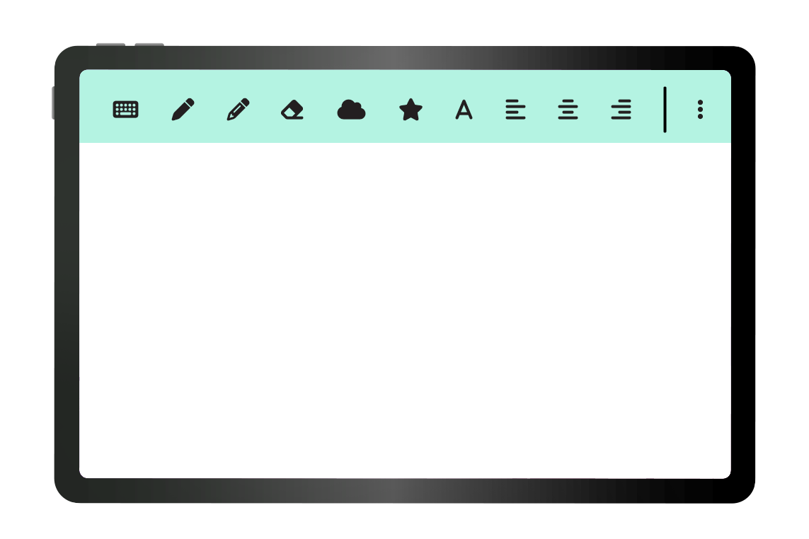
Things to Remember
Module Two | Navigating the Internet
Don't expect perfection – we're all learning together
Take breaks, step away whenever you need to
Questions are always welcome
Learning takes time (and that's okay!)
!
Notes:
Talk about how apps are not designed for us
Facilitator note about hospital codes: You may hear hospital announcements, known as codes, during the session.This can sometimes be distracting, but it is normal in a hospital setting. Your facilitator will let you know if any action is needed. If you need a break or want to talk, just let us know.

Slide 6

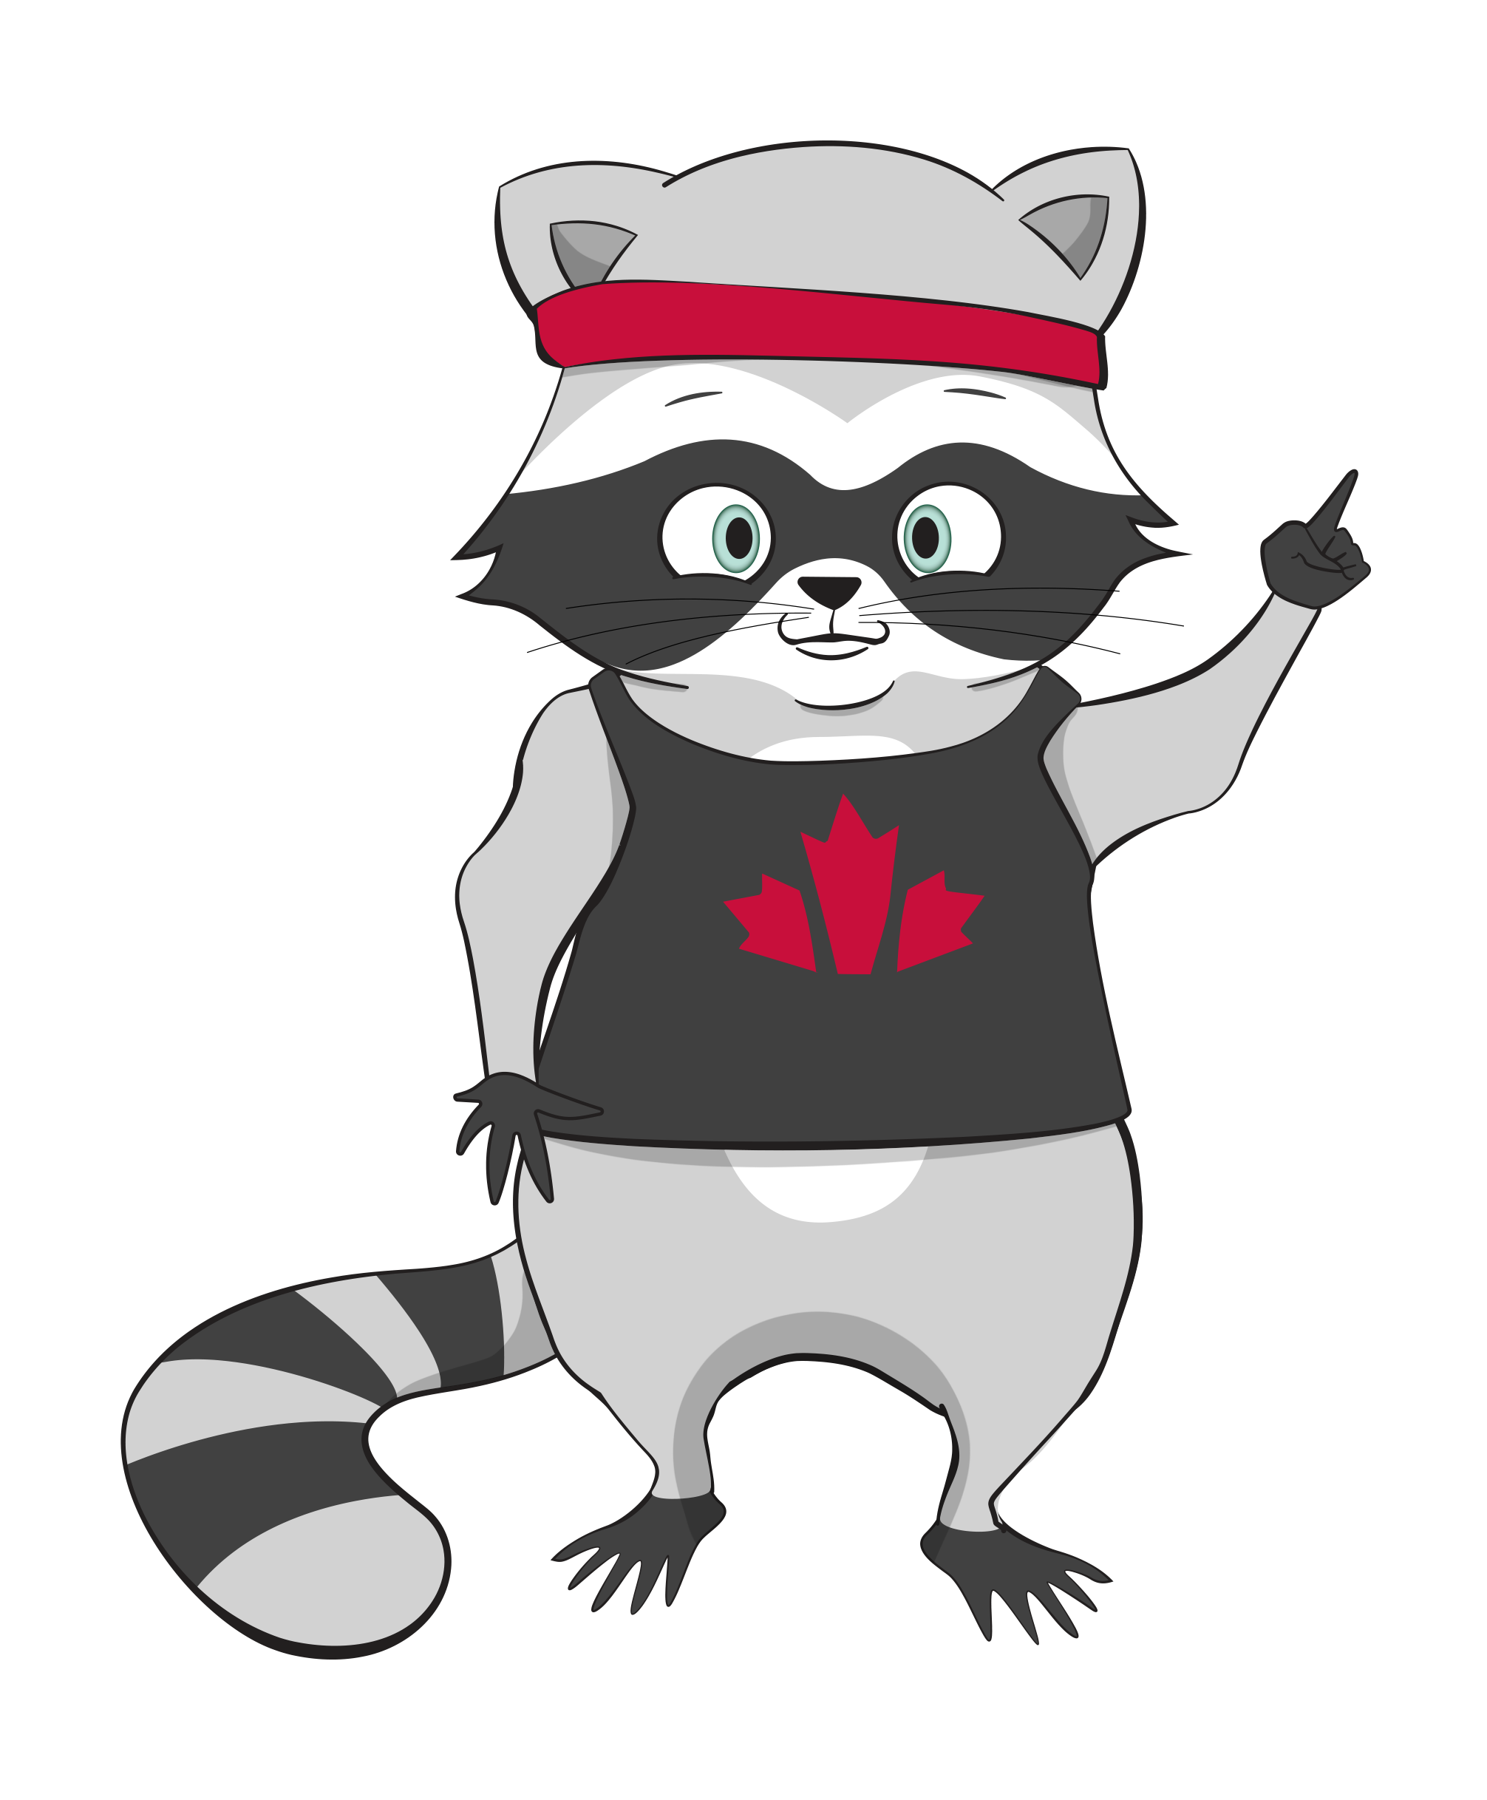
Warm-up Questions:
When you hear the word internet, what comes to mind?
What do you use the internet for, or what would you like to use it for?

Slide 7

Using the Android Keyboard
Module Two | Navigating the Internet
Last week, we learned how to tap, pinch and scroll on our screens.
But what happens when we want to type words?

Slide 8
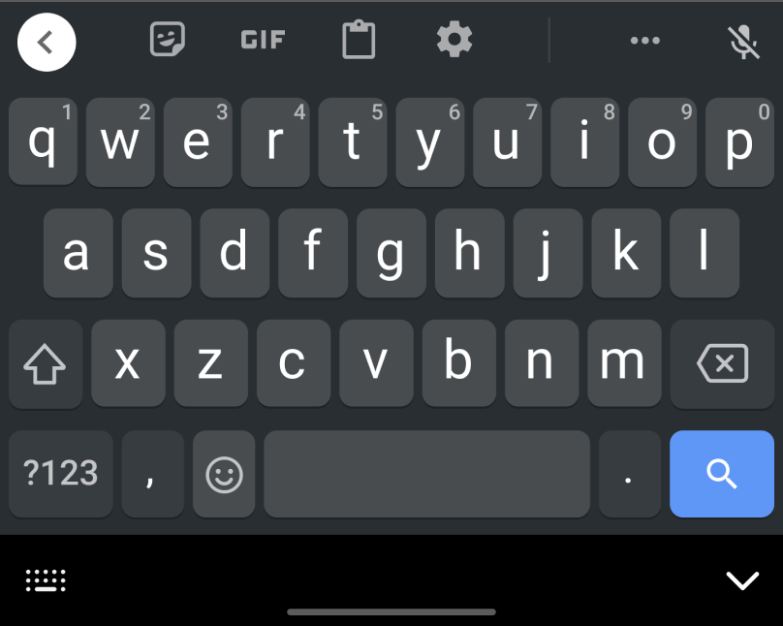
Using the Android Keyboard
Module Two | Navigating the Internet
To do that, we will
need the keyboard!

Slide 9
The On-Screen Keyboard
Module Two | Navigating the Internet
There’s a keyboard built into every tablet and smartphone.
The keyboard appears on the touch screen.
To save screen space, the keyboard only appears when there’s somewhere to type.
Let’s practice using the keyboard together!

Slide 10



Let’s Practice:
Keyboard Confidence
Open the DOORS App on your tablet.
Tap on “Keyboard Confidence” from the home screen.
Type the word as it appears
on the screen.
The keyboard will appear automatically when you tap on the typing area.
Take your time! There is no rush.

Slide 11






Icons on the Internet
Module Two | Navigating the Internet
Let’s look at some of the new icons you’ll see when you’re online:
Wi-Fi | Shows internet connection strength
Browser/Internet | Opens the web browser
Search | Lets you search for information
Back | Lets you return to the previous page
Tabs | Shows all open webpages on the browser
Bookmark | Saves a webpage to return to later

Slide 12

What is Wi-Fi?
Module Two | Navigating the Internet
Wi-Fi is a wireless connection that lets
your device access the internet.
You can get Wi-Fi from the following:
At home (through internet companies like Rogers or Bell)
In public places (like coffee shops, libraries, and hospitals)
Wi-fi doesn’t use data from a phone plan.

Slide 13


Home Wi-Fi vs. Public Wi-Fi
Module Two | Navigating the Internet
Home Wi-Fi
Public Wi-Fi
Faster — compared to public
Safer — password protected by you
Not time limited — You can stay connected as long as you are home.
Free — no cost to you!
Slower — more people are connected
Convenient — Great for browsing, viewing maps, and watching videos.

Slide 14

Wi-Fi Safety Tip
Module Two | Navigating the Internet
For personal things like online banking or accessing medical information, it’s better to wait to use your home Wi-Fi,
or to use cellular data.
Public Wi-Fi is great for browsing the internet, checking maps or watching videos.
This isn’t meant to scare you —
it’s just good to know!

Slide 15

What is Cellular Data?
Module Two | Navigating the Internet
Cellular Data (Data) comes from a phone plan you buy from companies like Koodo, Freedom, Rogers, Telus, etc.
Data connects you to the internet anywhere your phone has a signal (cellular service).
Data lets you access the internet without using Wi-Fi.

Slide 16

When Might You Use Data?
Module Two | Navigating the Internet
Using Google Maps when you are out on the street
Checking your email when you are taking the bus home
Searching for something on the internet when you are out
Watching videos or searching online on the go

Slide 17
Wi-Fi vs. Data: Quick Comparison
Module Two | Navigating the Internet
— Wi-Fi —
— Data —
Can access at home or in public spaces
Works only where there is
Wi-Fi is available
Best for watching videos & downloading files
Part of your phone plan
(limited amount)
Works almost anywhere
(spotty in rural areas)
Good for quick internet tasks
on the go

Slide 18

Let’s Practice:
Connecting to CAMH Wi-Fi
Find the settings app on the tablet
Open settings
Tap Wi-Fi
Choose CAMH Guest Wi-Fi
Enter the Wi-Fi password (see whiteboard)
Tap CONNECT
Try visiting a webpage to confirm it works

Slide 19
Reflection:
Making Connections
When do you think you
might choose to use Wi-Fi?
When do you think you
might choose to use Data?
There’s really no right answer. It depends on where you are, what you’re doing, and what you have access to.

Slide 20


Break
Take 10 minutes to stretch, get water, take care of yourself etc.

Slide 21




What is the Internet?
Module Two | Navigating the Internet
The Internet is a giant network of connected computers that share information.
When you look up a recipe, watch a video, check a map,
or read the news, you’re
using the internet.

Slide 22

What is an Internet Browser?
Module Two | Navigating the Internet
An Internet Browser (Browser) is the tool that lets you open and look at web pages on the internet.
Think of it like a door that helps you enter different
websites and view different webpages.

Slide 23




What is an Internet Browser?
Module Two | Navigating the Internet
Common internet browsers include:
Google Chrome: commonly used on android devices and the one used in DOORS Canada
Microsoft Edge:
commonly used on Microsoft products
Safari:
commonly used on Apple devices
Firefox:
Another browser that can be downloaded.

Slide 24
What is a Search Engine?
Module Two | Navigating the Internet
A search engine helps you find information on the internet.
When you type in something like “Who invented pizza?” it searches millions of websites and brings back the most relevant matches.

Slide 25
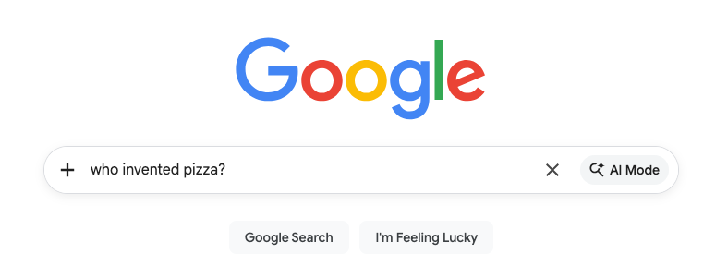
What is a Search Engine?
Module Two | Navigating the Internet
Examples of a search engine include:
Google
Bing
DuckDuckGo

Slide 26


What Does the Padlock Mean?
Module Two | Navigating the Internet
When you visit a website, you might see a small padlock in the address bar.
= Secure Website
= Unsecure Website
Your information is protected and encrypted
Safe to enter personal info
Don’t enter passwords, email, or payment info
Might be okay to read, but not okay to share personal info

Slide 27
Let’s Practice:
Searching the Internet
Open the Chrome App (tap browser icon)
Tap the search bar
Type something – or – ask a question and tap “enter”
Tap one of the website results that appears
Use the back button if the website doesn’t have the information you were looking for
Bookmark the page to save it for later!

Slide 28
Today’s Achievements
Module Two | Navigating the Internet
Today, you achieved the following:
Connected to Wi-Fi
Learned about Wi-Fi and Cellular Data
Learned about the internet, search engines, and websites
Searched the internet
Progress doesn’t have to be loud to be meaningful. What you practiced this week matters.
The internet is something many people use every day without thinking about it. Taking the time to understand it thoughtfully is a real investment in yourself.
Notes:
Those are real skills you can be proud of!

Slide 29
Wrap-Up & Reflection
Module Two | Navigating the Internet
What’s one thing you learned today that felt new or surprising?
What’s something you learned today that you want to practice more?
Remember — Learning technology
takes time. You’re doing great!

Slide 30

Looking Ahead
Module Three | Staying Safe Online
Great work today!
See you on April 9 at 1:00!
Here is a look ahead at Module 3, where we will learn about:
Staying safe online
Creating strong passwords
Spotting internet scams
Notes:
You'll use the same icons you learned today - the magnifying glass for search, the gear for settings. See you then!

