Slide 1

Module One
Getting to Know Your Device

Slide 2


Today’s Agenda
Module One | Getting to Know Your Device
Introductions and Housekeeping — 10 mins
What Devices Can Do for Us — 10 mins
Getting to Know Your Tablet — 15 mins
Let’s Practice: Gestures and Touch — 15 mins
Break — 5 mins
Let’s Practice: Icons and Symbols — 10 mins
Everyday Tools Practice — 15 mins
Wrap-up and Reflection — 10 mins
Notes:
Hey everyone – this is what we’re going to get through today. Sounds like a lot – let’s get started!

Slide 3
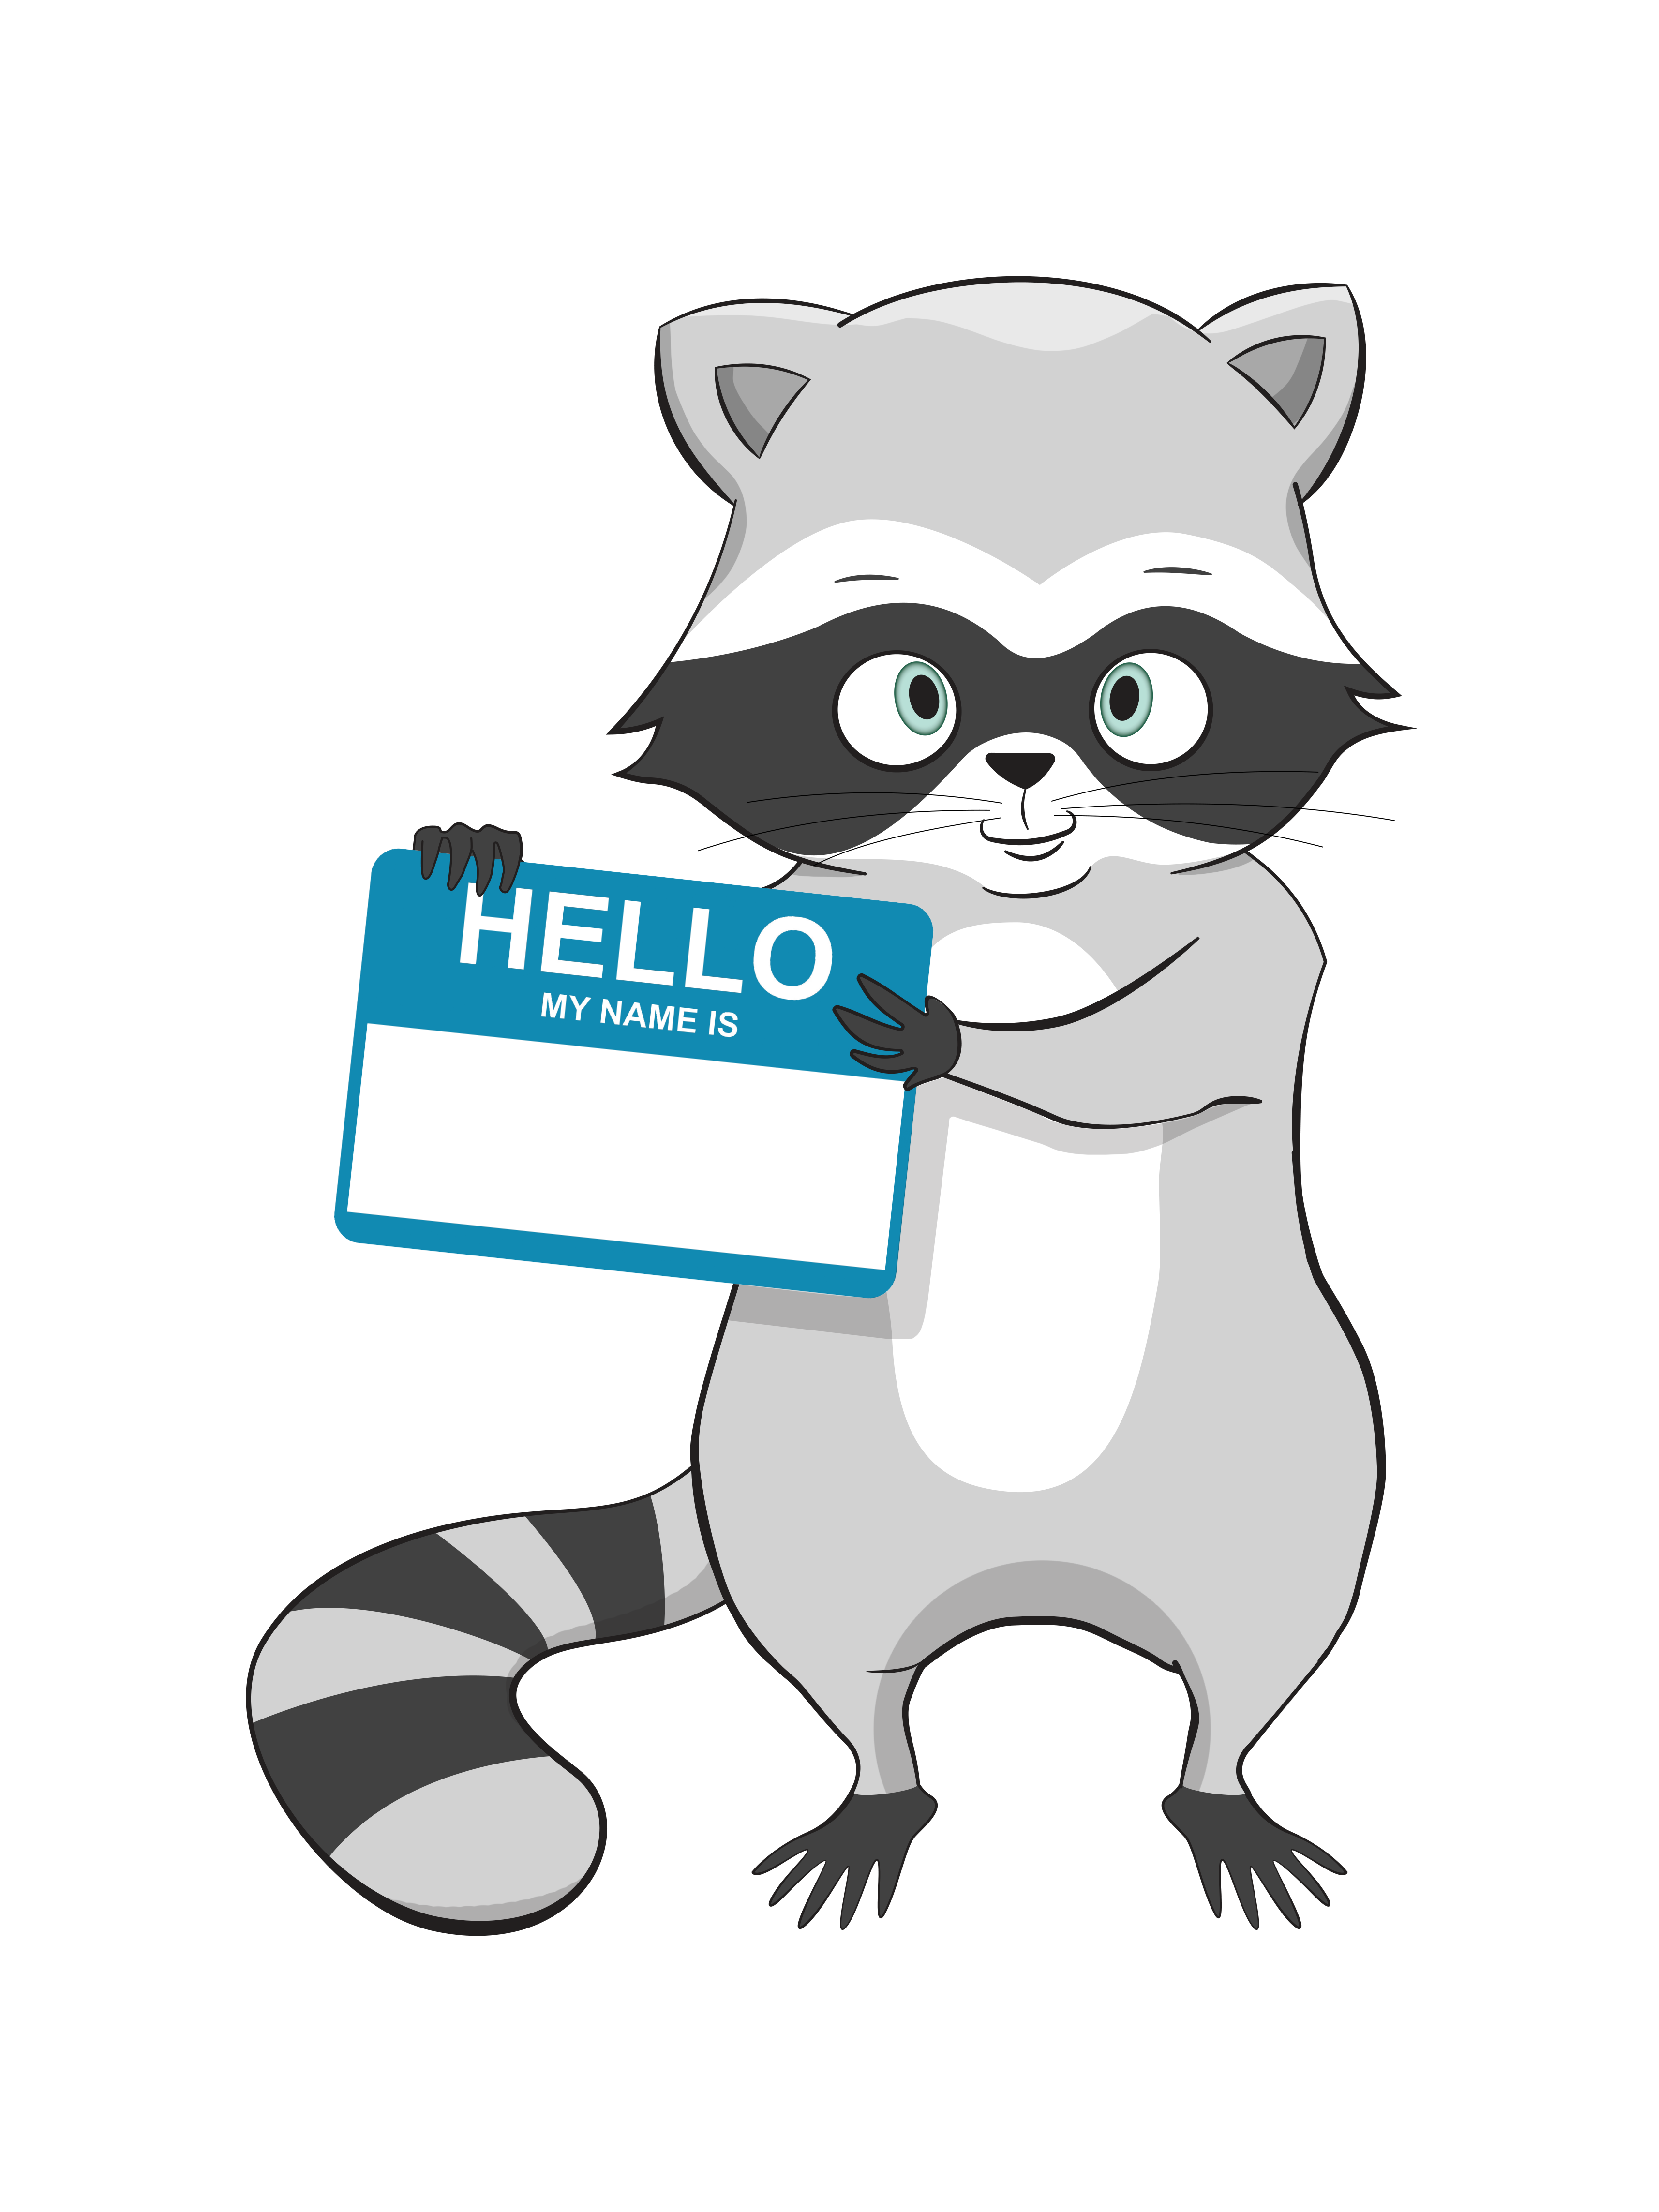
Introductions
Module One | Getting to Know Your Device
Before we dive in, let’s get to know one another a little bit better. Please share:
Your name
Something you enjoy doing in your free time
One thing you hope to learn or feel more comfortable doing

Slide 4

Group Guidelines
Module One | Getting to Know Your Device
• Be respectful of each other and everyone’s privacy
• Be kind and supportive, including taking turns talking and listening
• Honour Confidentiality – take what you learn but leave the names behind
• Unless asked, try not to offer advice
• Participate in the way that works best for you
• There are NO stupid questions!!!!!!!
Have fun — we’re all learning together!
Notes:
Note about respectful - Confidentiality – take what you learn but leave the names behind

Slide 5


Today’s Goals
Module One | Getting to Know Your Device
Today, we are going to
explore our devices together!
We will be covering how to:
Turn a device on and off
Use basic gestures like tap, swipe, and zoom
Recognize common icons
Use everyday tools like the clock to set reminders

Slide 6
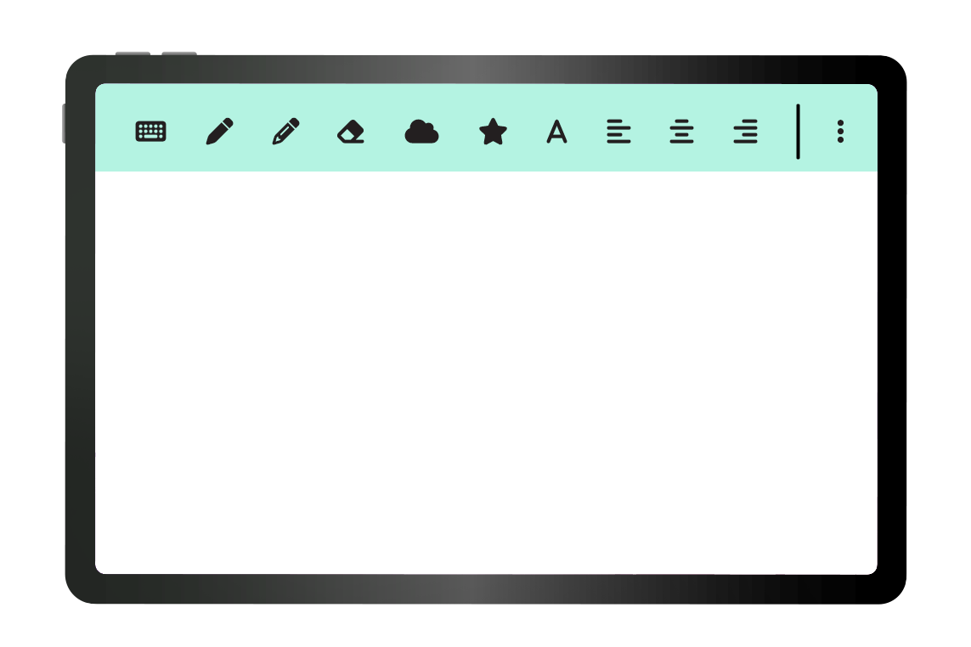
Things to Remember
Module One | Getting to Know Your Device
Don't expect perfection –
we're all learning together
Take breaks, step away whenever you need to
Questions are always welcome
Learning takes time !
Notes:
Talk about how apps are not designed for us
Facilitator note about hospital codes: You may hear hospital announcements, known as codes, during the session.This can sometimes be distracting, but it is normal in a hospital setting. Your facilitator will let you know if any action is needed. If you need a break or want to talk, just let us know.

Slide 7
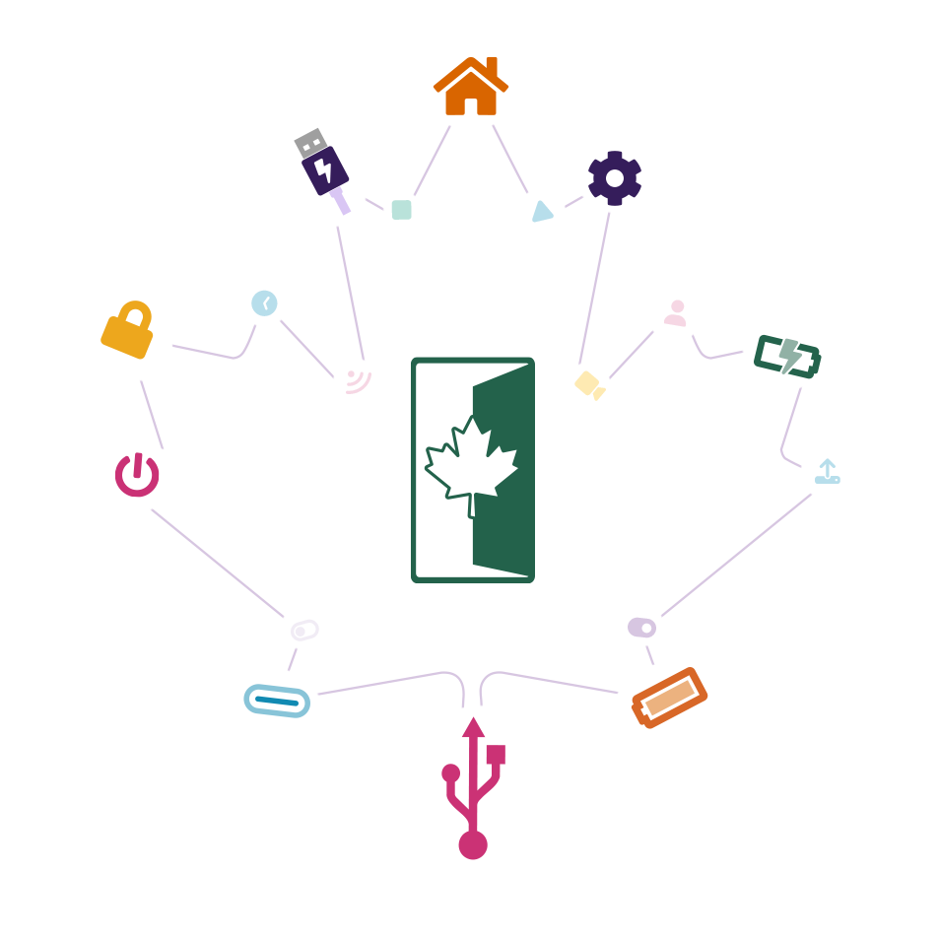
What Can We Do With a Digital Device?
Module One | Getting to Know Your Device
Connect with people (calling, texting, video chatting)
Stay organized (reminders, calendar, notes)
Find information (maps, directions, searching)
Notes:
Not only that but (next slide)

Slide 8
What Can We Do With a Digital Device?
Module One | Getting to Know Your Device
Be creative (photos, music, drawing)
Take care of ourselves (medication reminders, calming music, tracking appointments)
Access support (online groups, mental health resources)

Slide 9
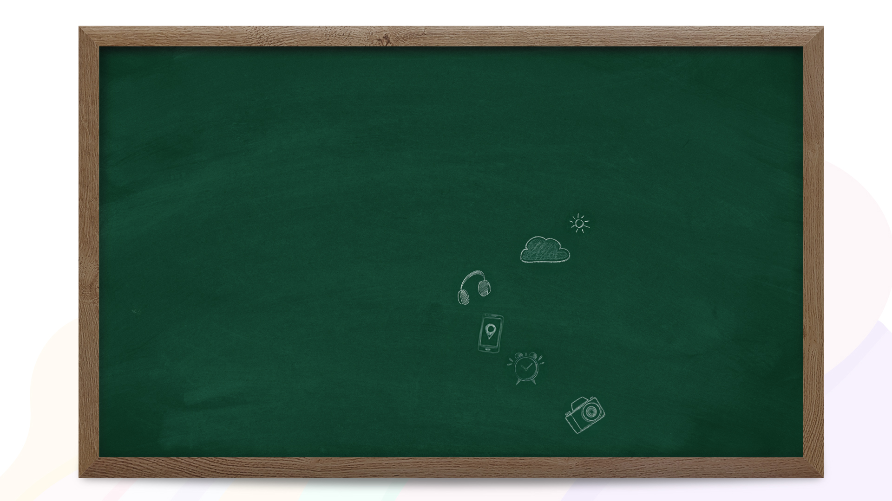

Discussion:
What Would You Like to Learn?
What's one way you'd like to use a device in your daily life?
Checking the weather before going out
Listening to music or a podcast
Using maps to find a new location
Setting reminders to take medications
Taking photos of things that make you happy

Slide 10

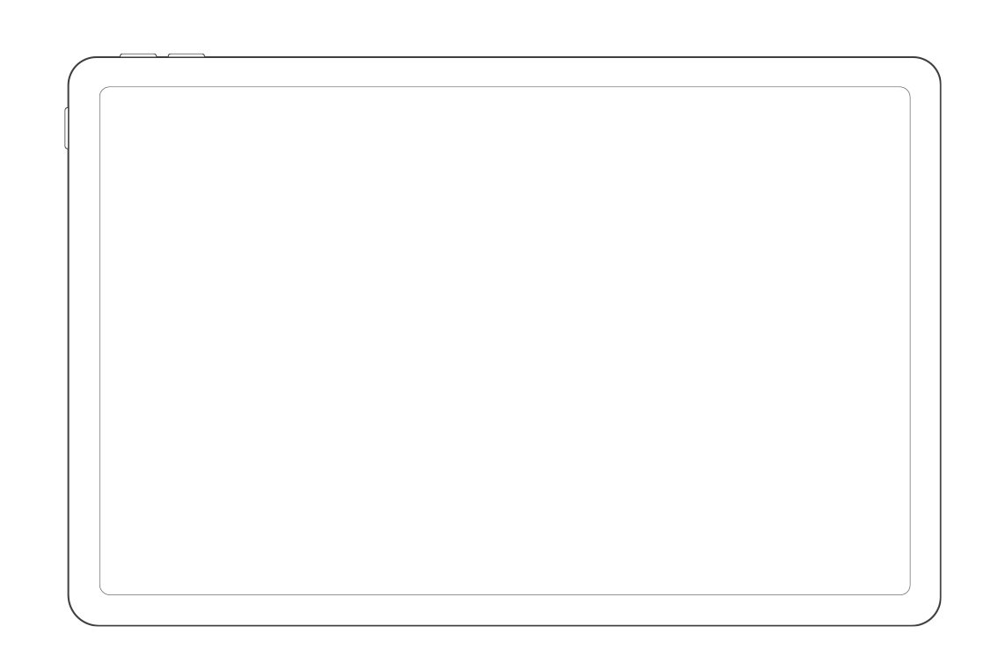

Meet Your Tablet
Module One | Getting to Know Your Device
We'll be working with Lenovo tablets
in this program, but most of the same features apply to smartphones and laptops too.
Let’s get familiar with the tablet you’ll be using for DOORS.
Notes:
FN: Hand out tablets in sleeves.

Slide 11


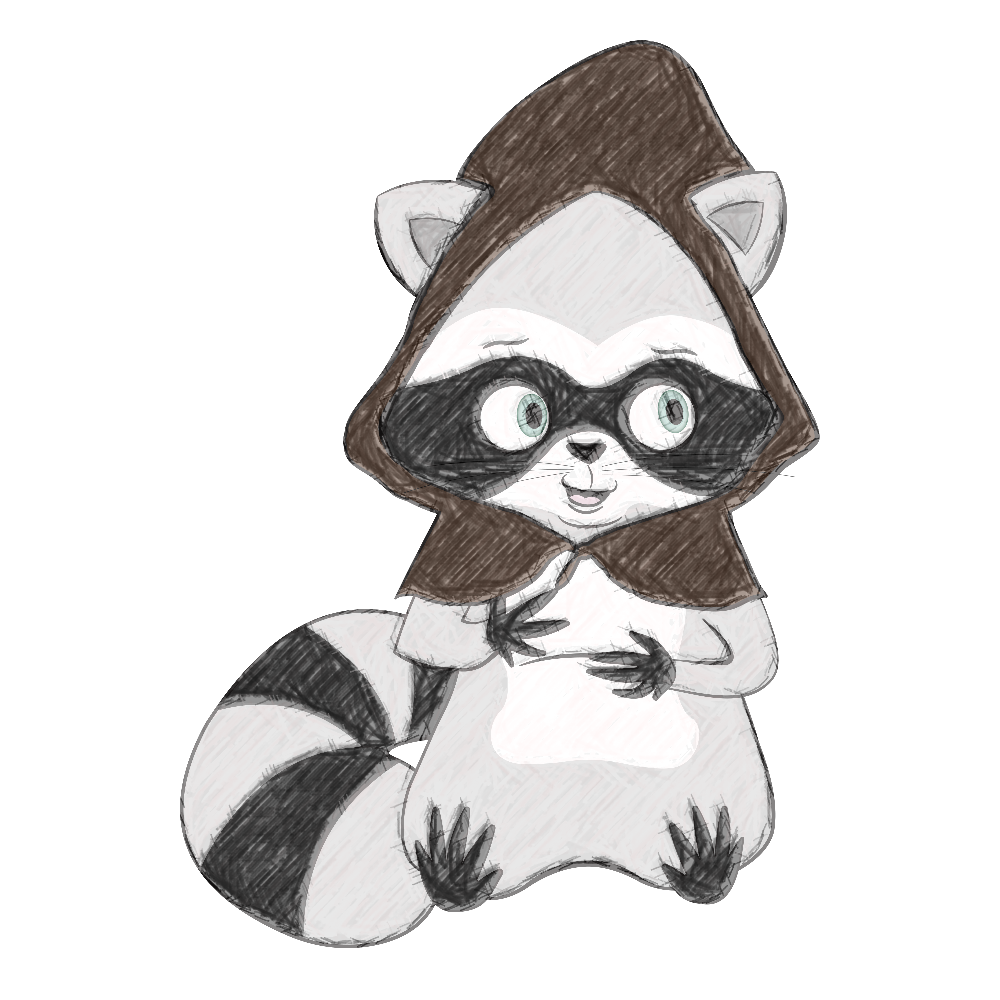
The Sleeve Rule
Listen — strange raccoons in
hoods distributing sleeve policies is no basis for a system of tablet governance.
When we're using our tablets, they stay on or over the sleeve.
When we're not using our tablets, they go back in the sleeve.
Notes:
Demonstrate holding the tablet above the sleeve on the table.

Slide 12
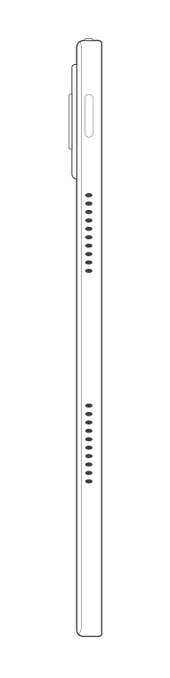
Parts of a Tablet
Module One | Getting to Know Your Device
Let's take a quick tour of your tablet:
Front: Screen (where you touch), camera, speaker
Sides: Volume buttons, memory card slot
Top: Power button
Bottom: Charging port, headphone jack
Notes:
You don't need to memorize these - we'll use them as we go.

Slide 13
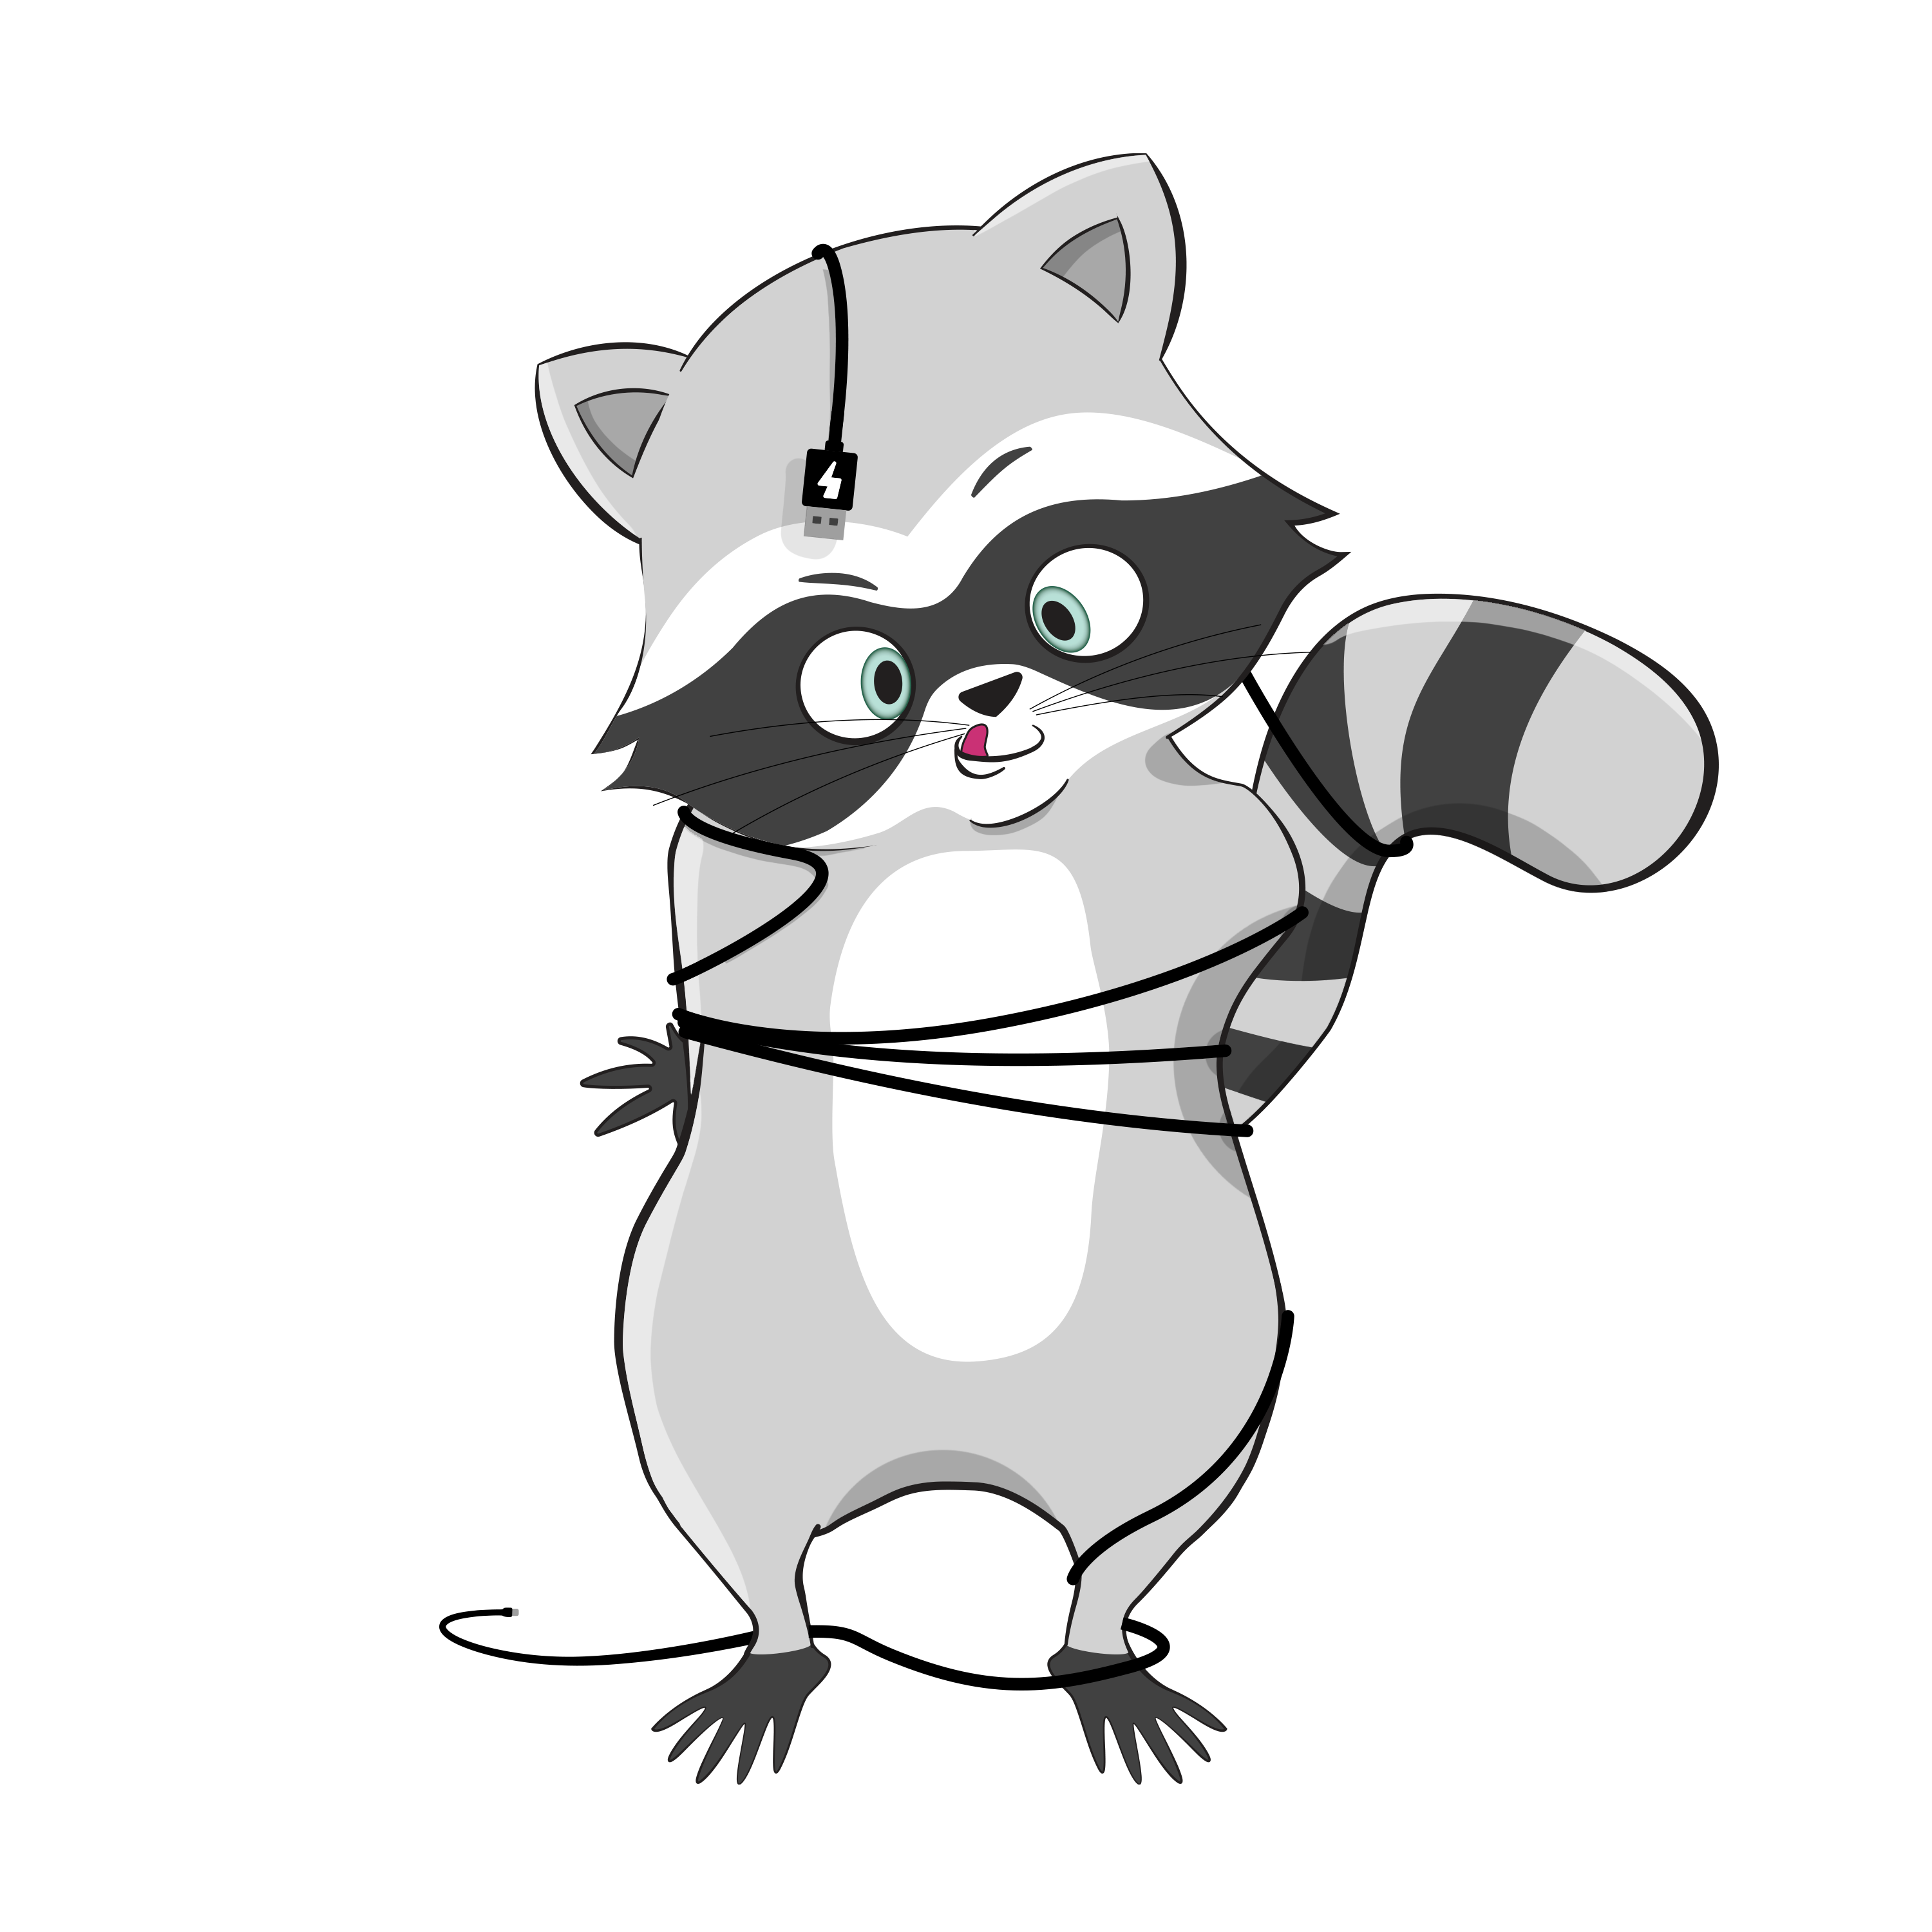
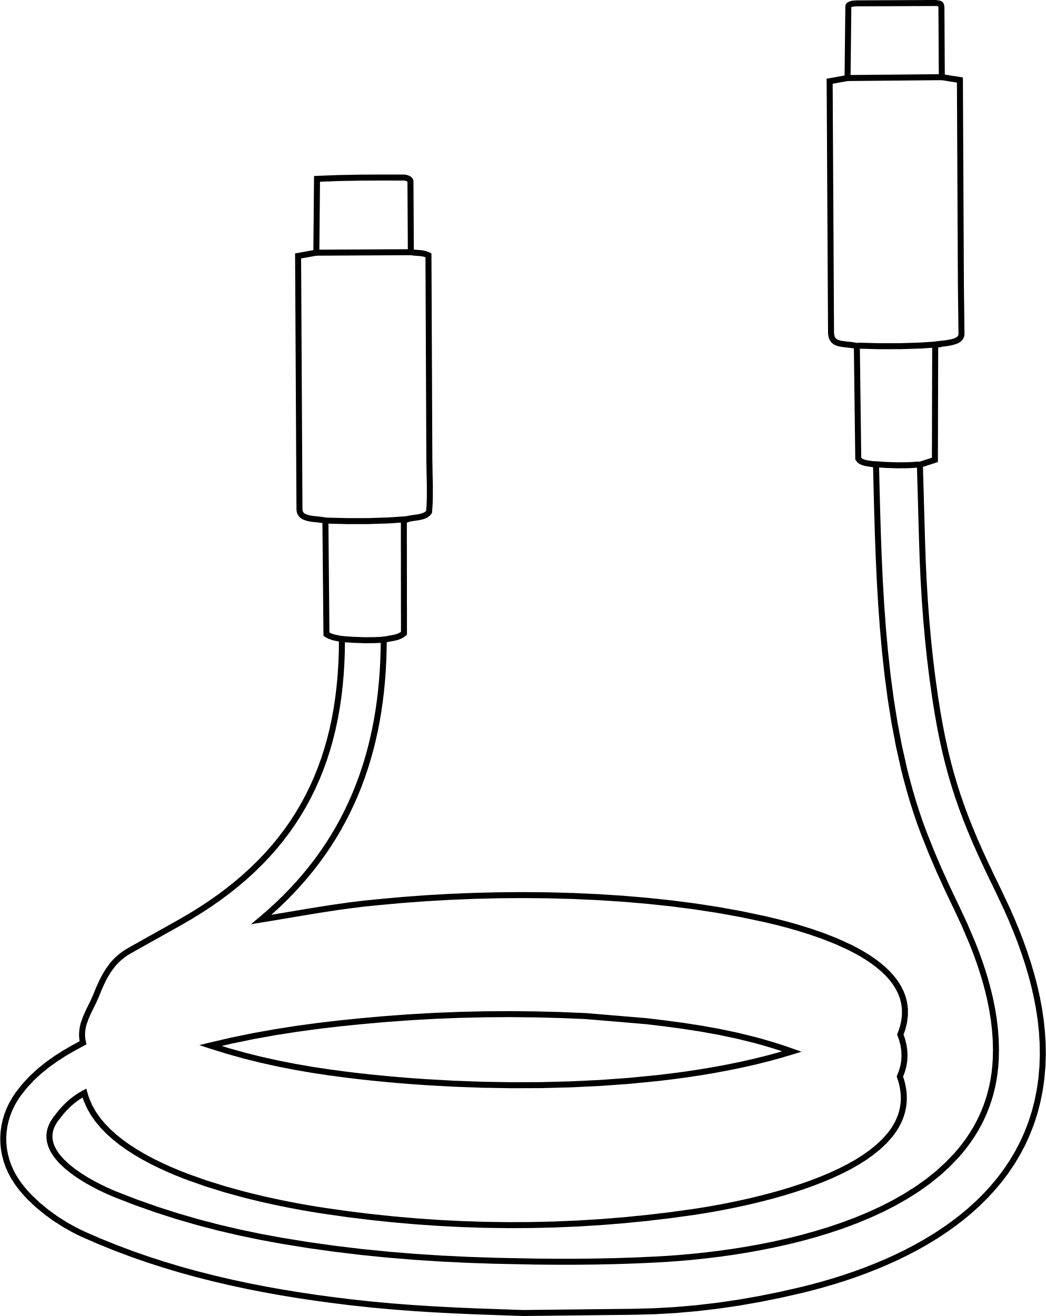
Cables & Charging
Module One | Getting to Know Your Device
Your tablet needs power to work.
The Lenovo K11 tablets we're using in this program charge with a USB-C cable.
One end plugs into the tablet (bottom)
The other end plugs into a power outlet
Both ends are the same
Notes:
Demo plugging in tablet and seeing the charging indicator appear. Note that this is an example of icons being used to tell us something about the system – in this case that it’s charging.

Slide 14
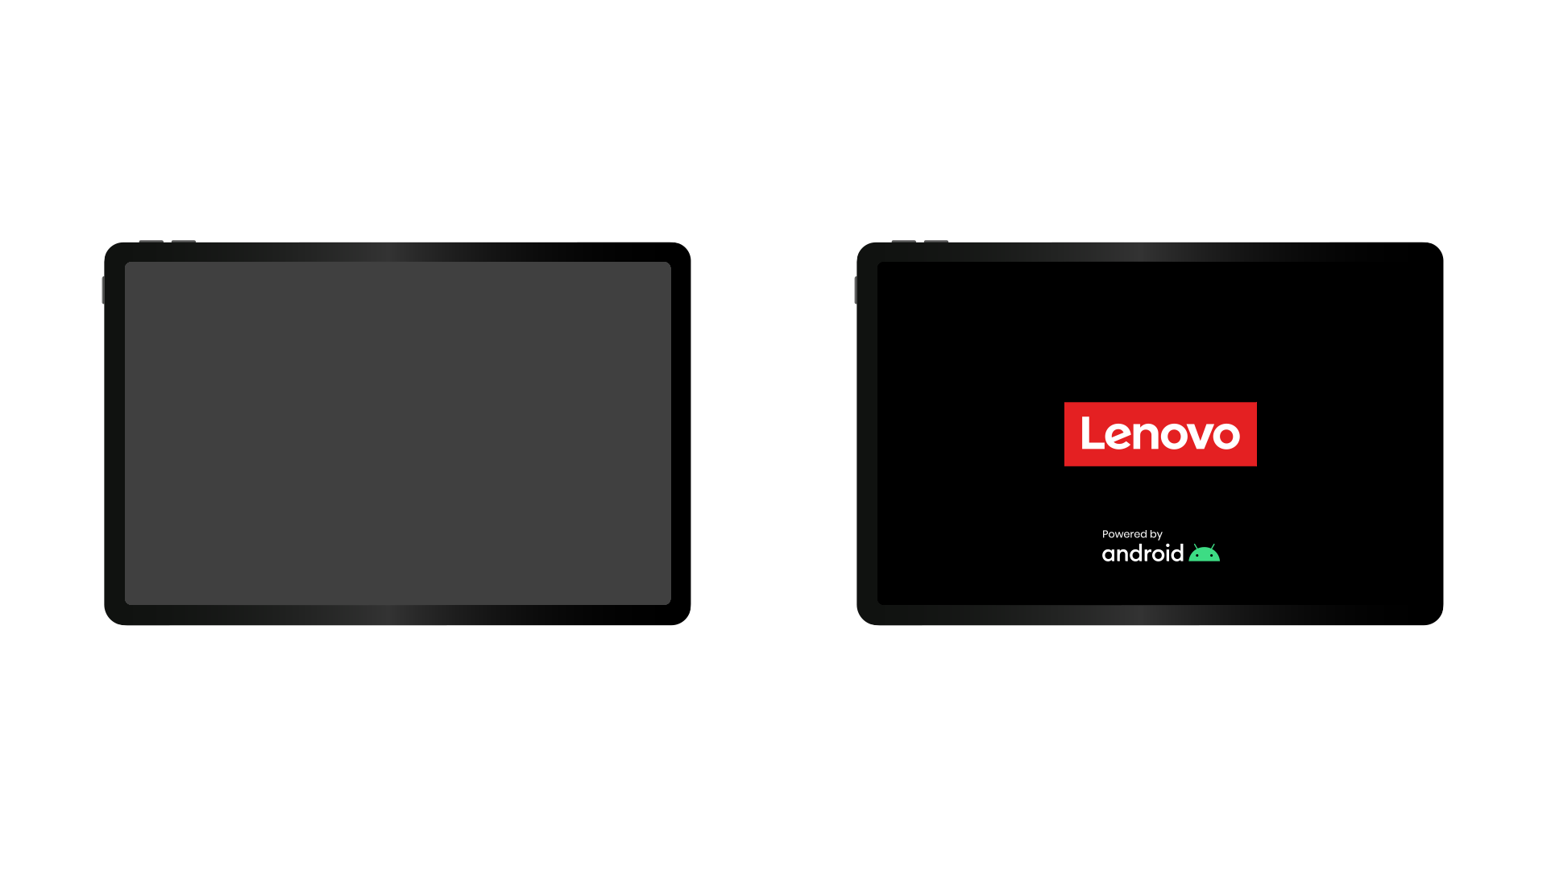
Let’s Power On!
Module One | Getting to Know Your Device
Everyone turn on your tablet:
Find the power button (on top)
Press and hold it for a few seconds
Wait for the screen to light up
Notes:
Raise your hand when you see your screen turn on!
Helper and fac assist anyone having trouble

Slide 15
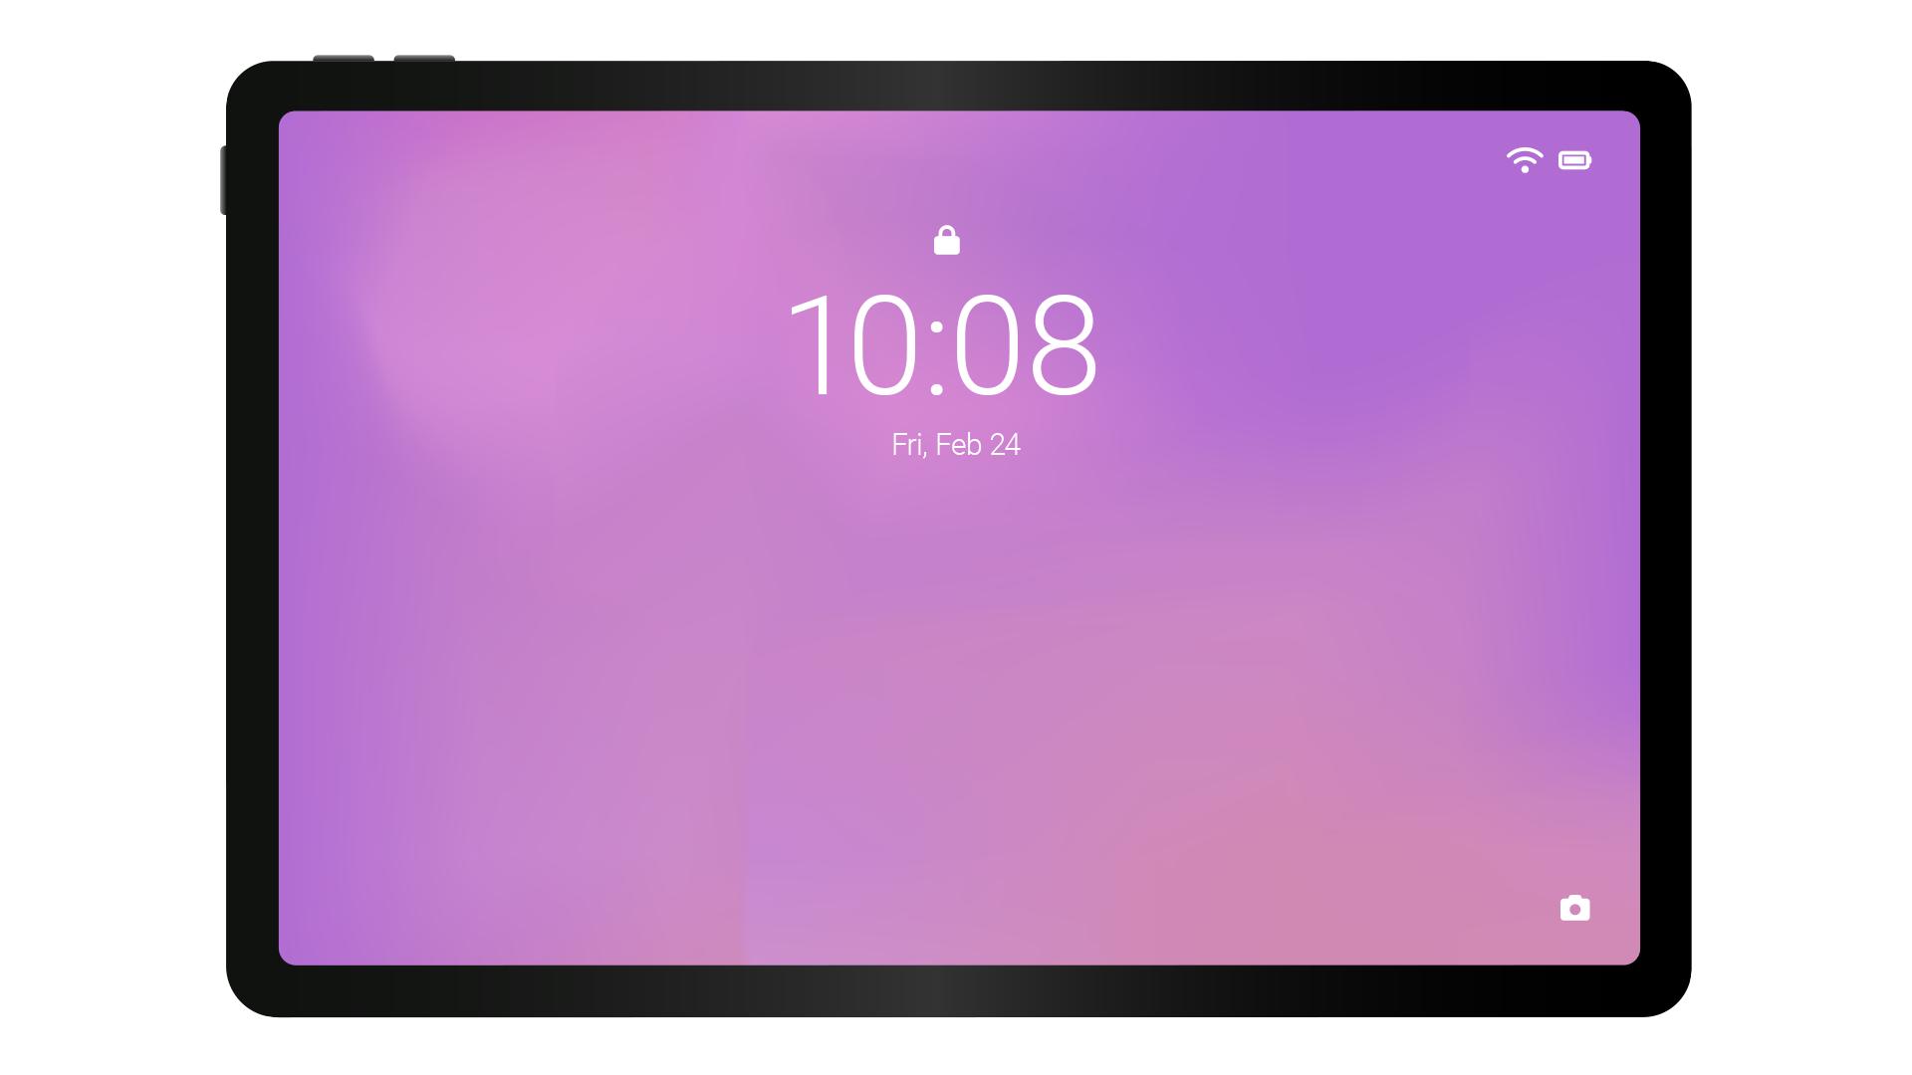
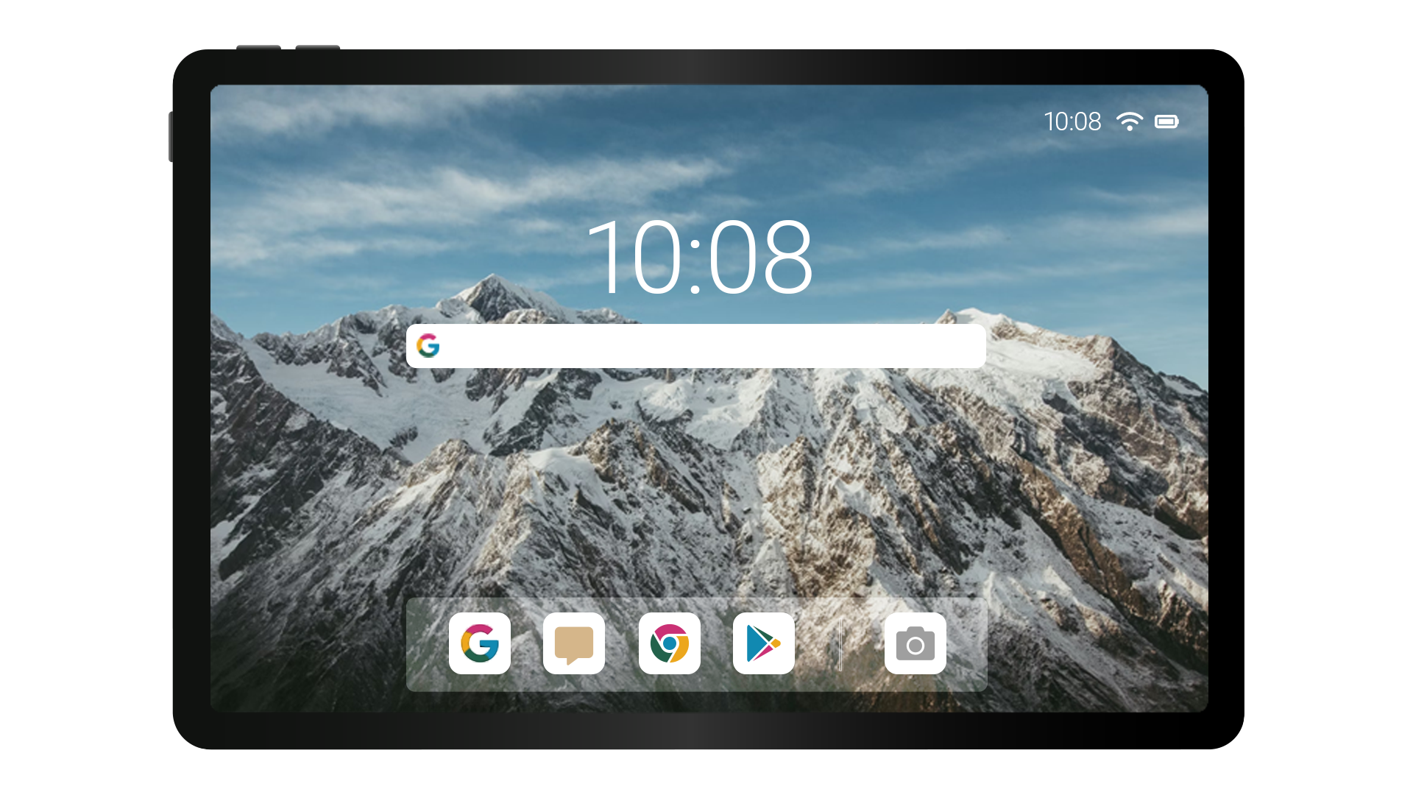
Lock Screen vs Home Screen
Module One | Getting to Know Your Device
When your device first wakes up, you see
the lock screen. It shows thing like:
the time, date, and notifications.
Think of it as your front door -
it lets you in but keeps strangers out!
When you unlock your device, you see
the home screen where your apps live.
This is where most of the action happens.
This is your living room -
it’s your main space for everyday activity.
Remember - Learning technology takes time. You’re doing great!

Slide 16
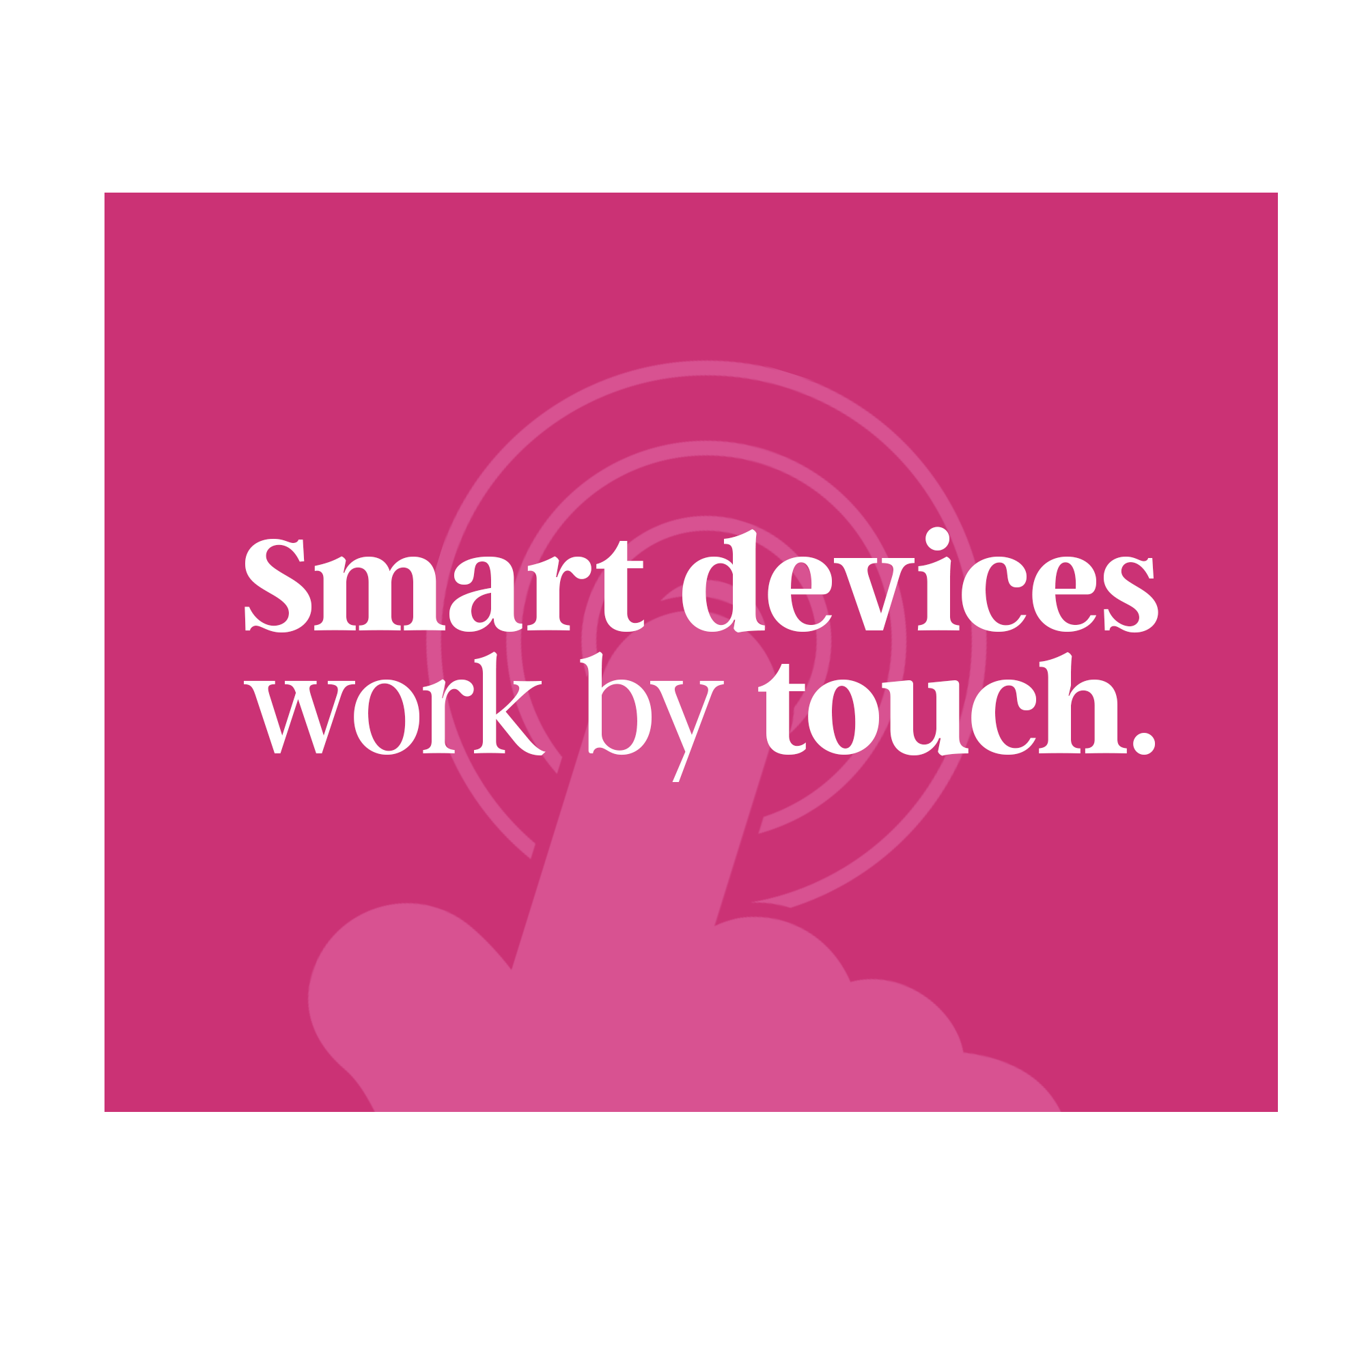
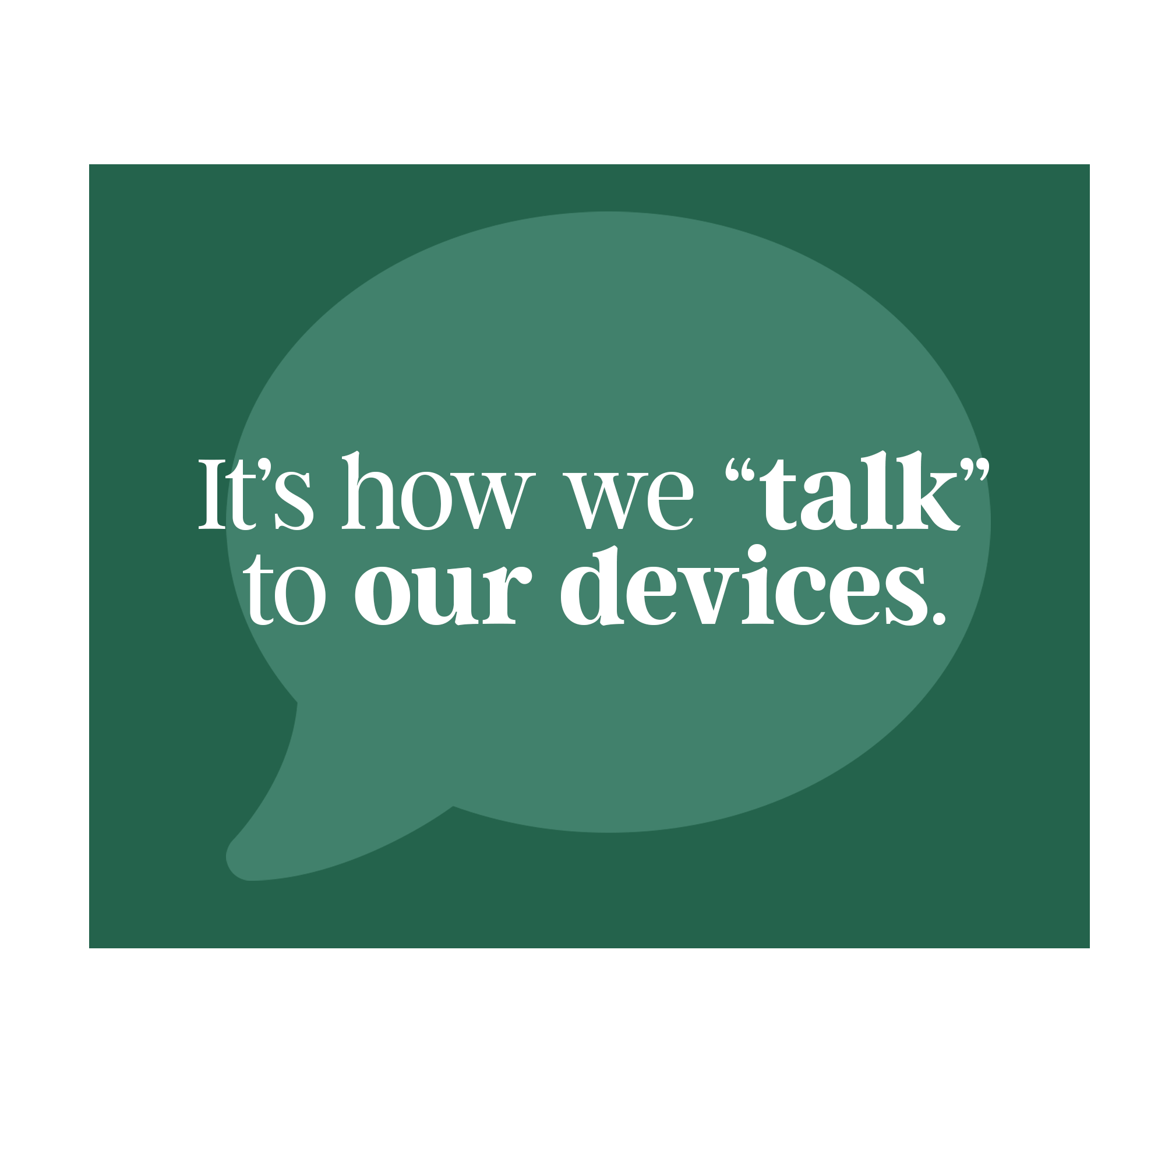
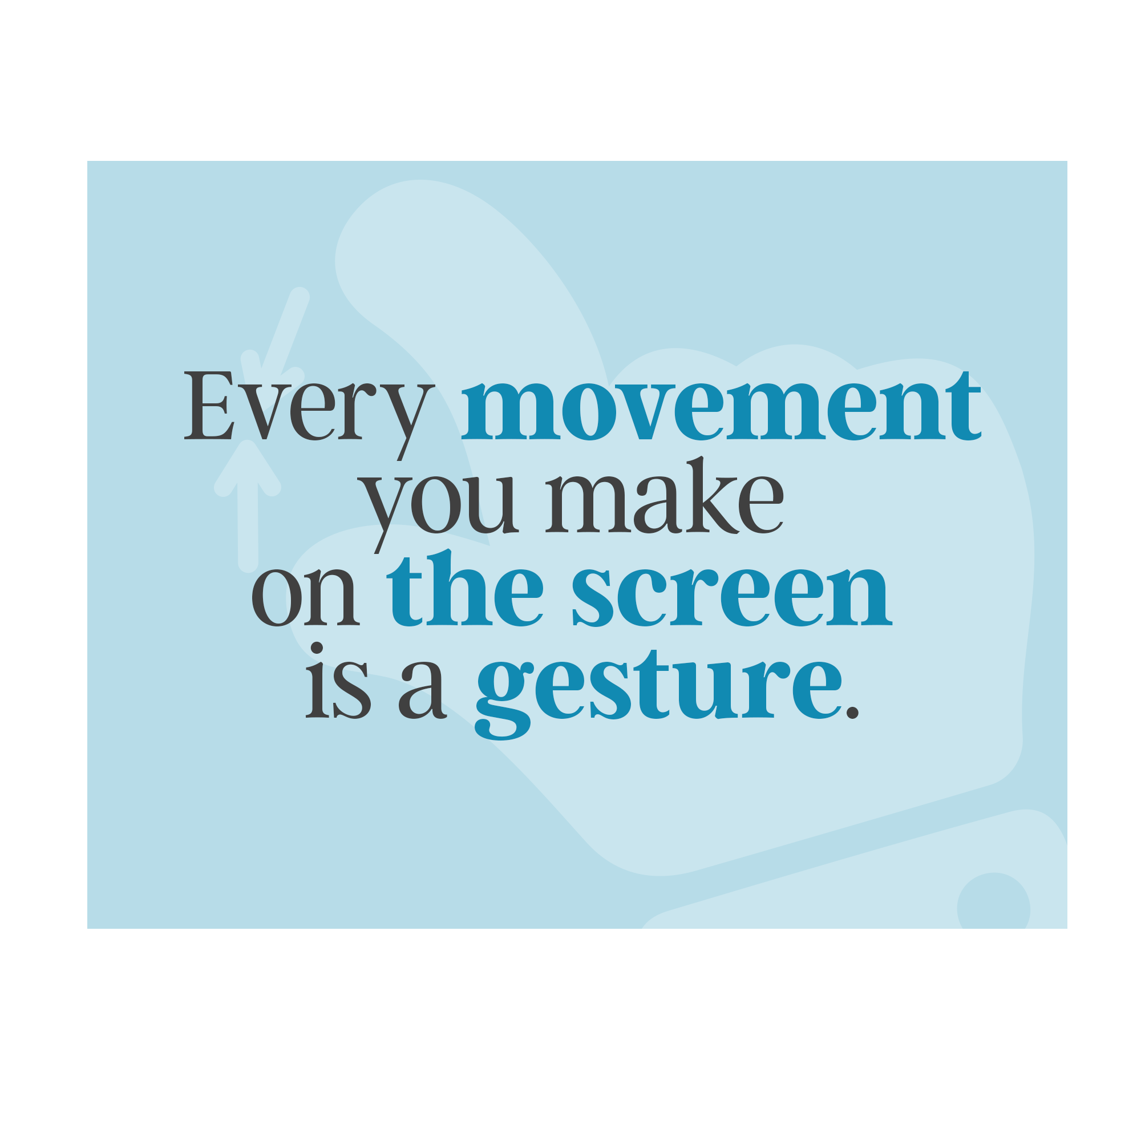

Using Touch & Gestures
Module One | Getting to Know Your Device

Slide 17
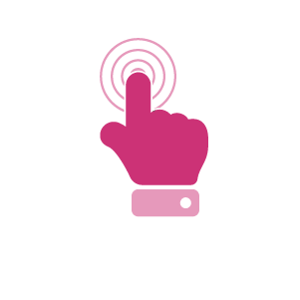

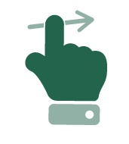
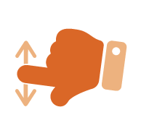
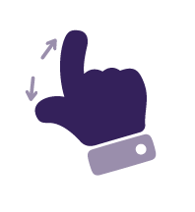
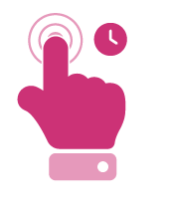
Basic Gestures
Module One | Getting to Know Your Device
Tap | Touch once quickly (selects something)
Double Tap | Tap twice quickly (zooms or highlights)
Swipe | Move finger across screen (changes screens)
Scroll | Move up or down a page
Pinch & Zoom | Two fingers together or apart (makes things bigger or smaller)
Tap & Hold | Touch and keep finger on screen for a few seconds (opens options)

Slide 18
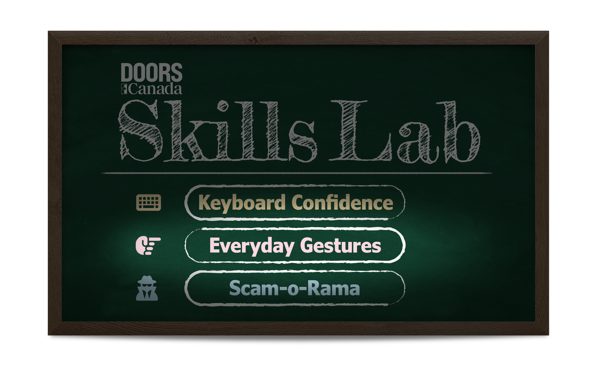
Practicing Gestures
Module One | Getting to Know Your Device
Now it’s your turn to practice!
Open the DOORS Canada Skills Lab app on your tablet and tap on “Everyday Gestures”
Notes:
Walk through the first activities together

Slide 19
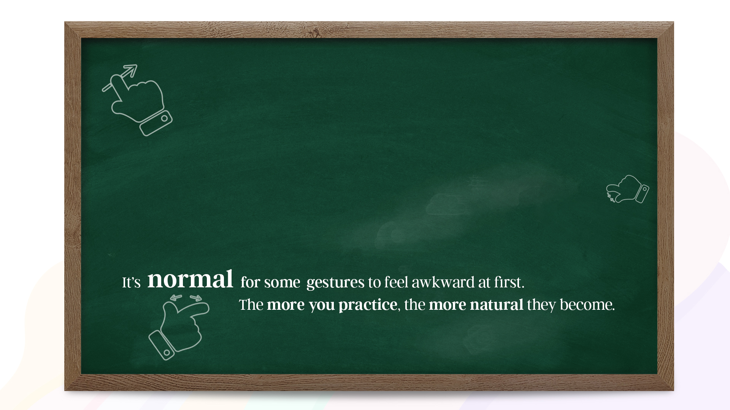
Reflection:
Gestures
Which gestures felt easy?
Which felt difficult?

Slide 20



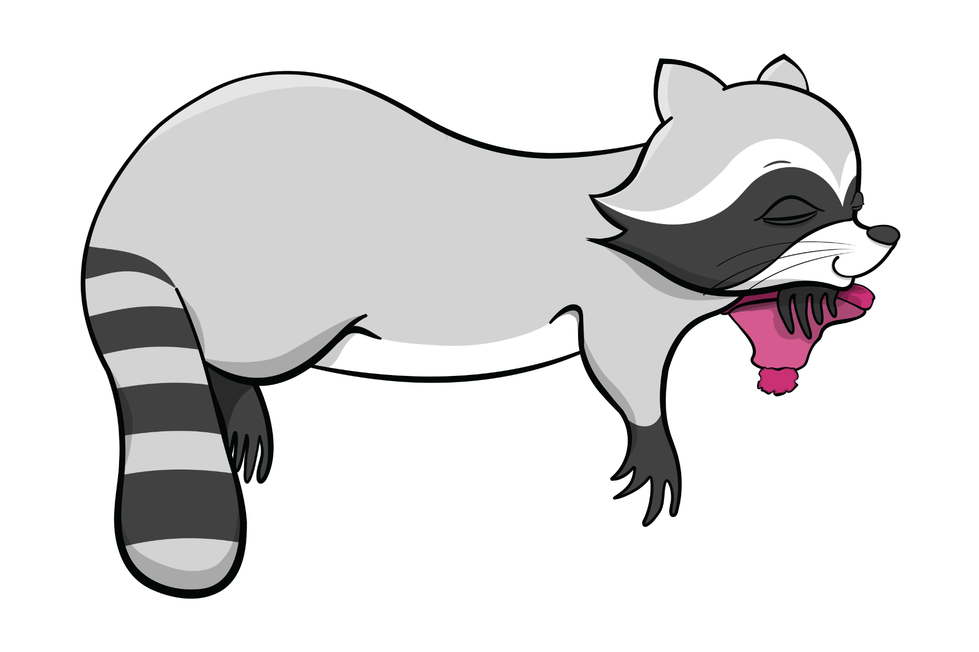
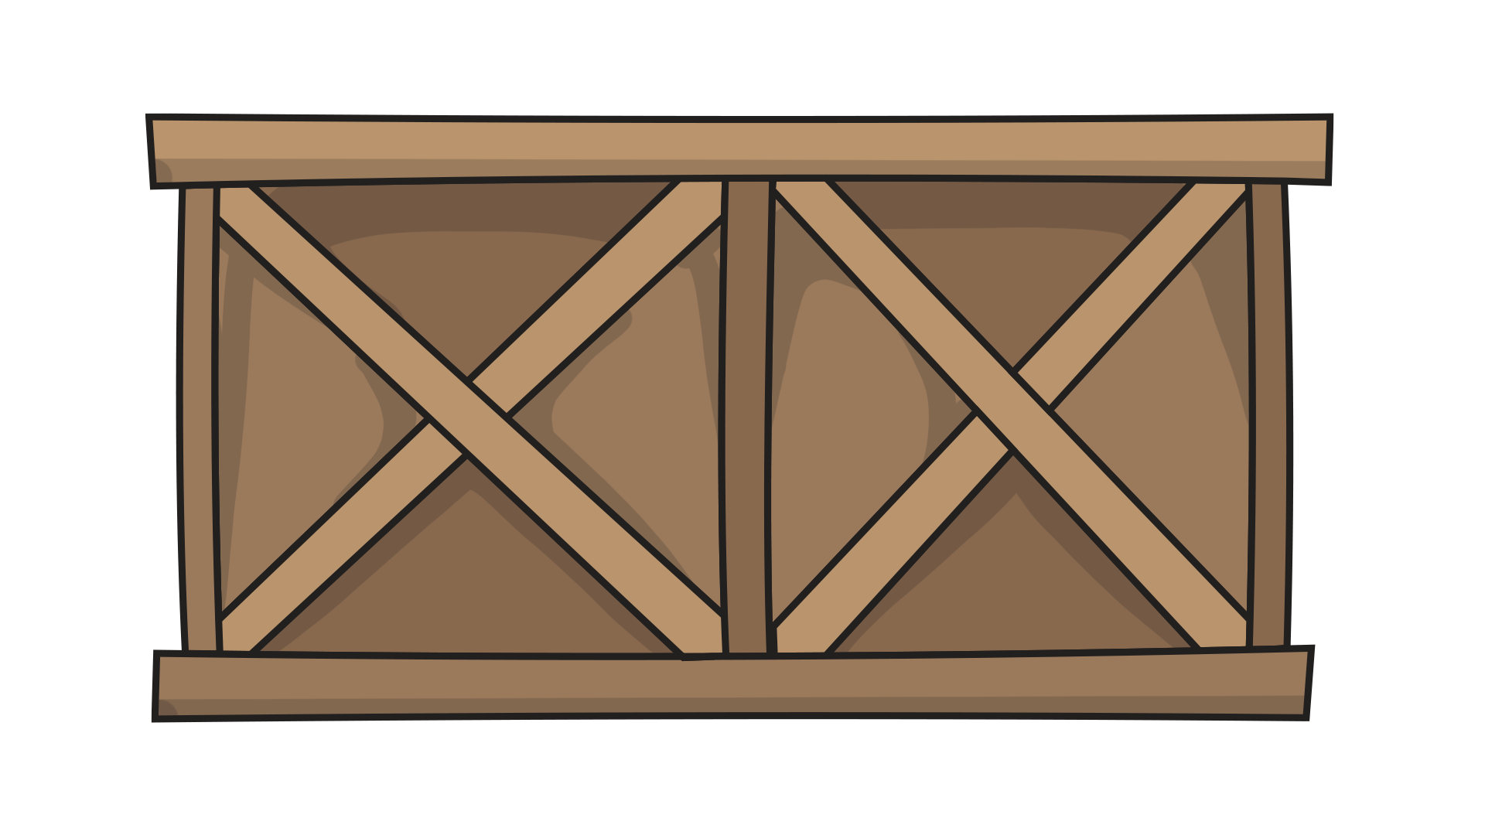

Break
Take 10 minutes to stretch, get water, take care of yourself etc.
Notes:
10 minutes to stretch, get water, take care of yourself etc.

Slide 21
Icons: A Universal Language
Module One | Getting to Know Your Device
Recognize it once. Use it anywhere.
One of the first steps in digital literacy is learning to recognize icons. Icons are the small images that guide you through apps, websites, and devices.
Icons are little pictures that tell us
what we can do.
Pro-tip: Many of the same icons appear everywhere - on your tablet, your phone, websites, and apps.
Once you learn what an icon means, you'll recognize it no matter where you see it.

Slide 22
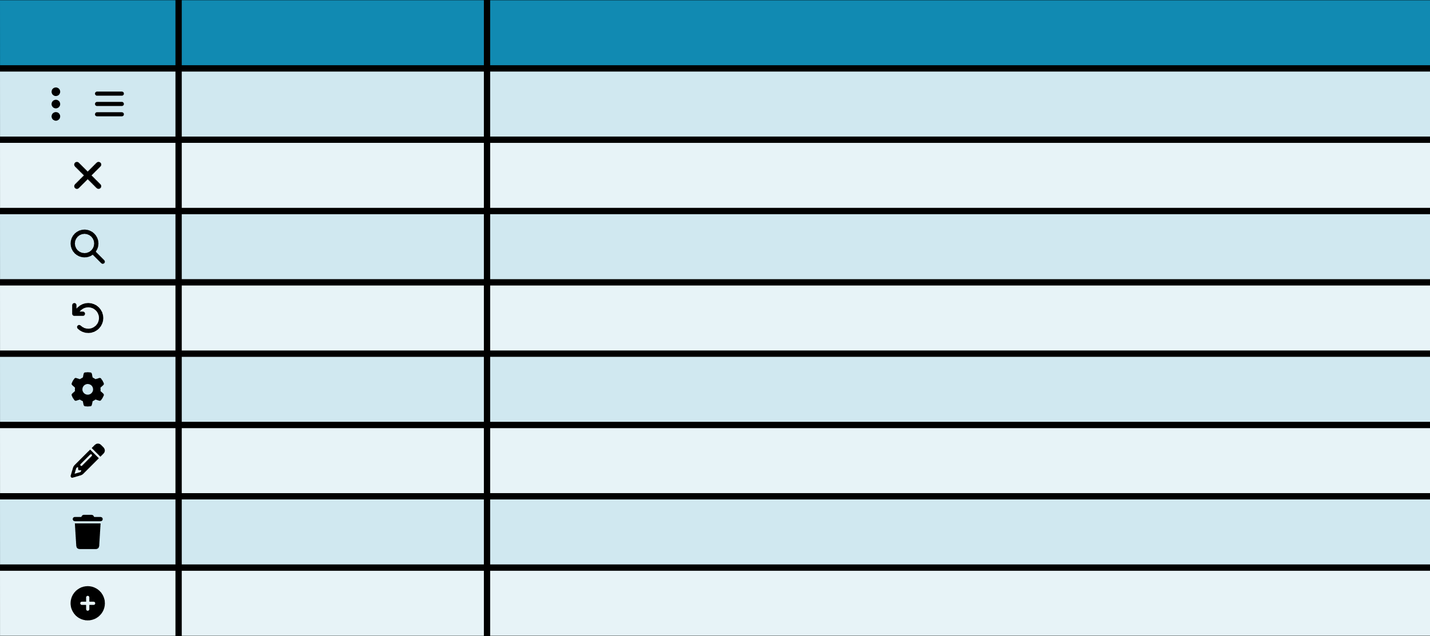
Icons You’ll See Everywhere
Module One | Getting to Know Your Device
Icon
Name
Description
Three Dots / Hamburger
Shows more options or additional settings
Close / Cancel
Closes the screen or app without saving
Magnifying Glass / Search
Magnify or zoom-in on something – or – search for something
Undo / Return
Go back to the last page or undo last step
Settings
The menu where you change how your device looks or works
Pencil / Edit
Edit, write or change something that already exists
Trash Can
Delete something
Plus / More
Add or create something new

Slide 23

Activity:
Icon Scavenger Hunt
Let’s practice identifying icons together.
Use the handout to match each icon with its meaning.
Trust your best guess, we’ll review as a group
Notes:
Once we can recognize these symbols we’ll be able to find our way around a tablet or phone – even if the software

Slide 24

Everyday Tools
Module One | Getting to Know Your Device
Camera: Takes photos
Calculator: Do math
Clock: Set alarms and timers
Maps: Find directions
Android tablets come with built-in apps that you can use right now.
Notes:
Point out the app icons on the home screen. Let's practice using one together.

Slide 25

Activity:
Set an Alarm
Now that we’re familiar with some of the everyday tools on our tablets,
let’s practice setting an alarm together.
Find the clock app on your home screen
Tap to open it
Find the alarm section
Set an alarm for 2 minutes from now
Notes:
Fac walk through then assist students

Slide 26
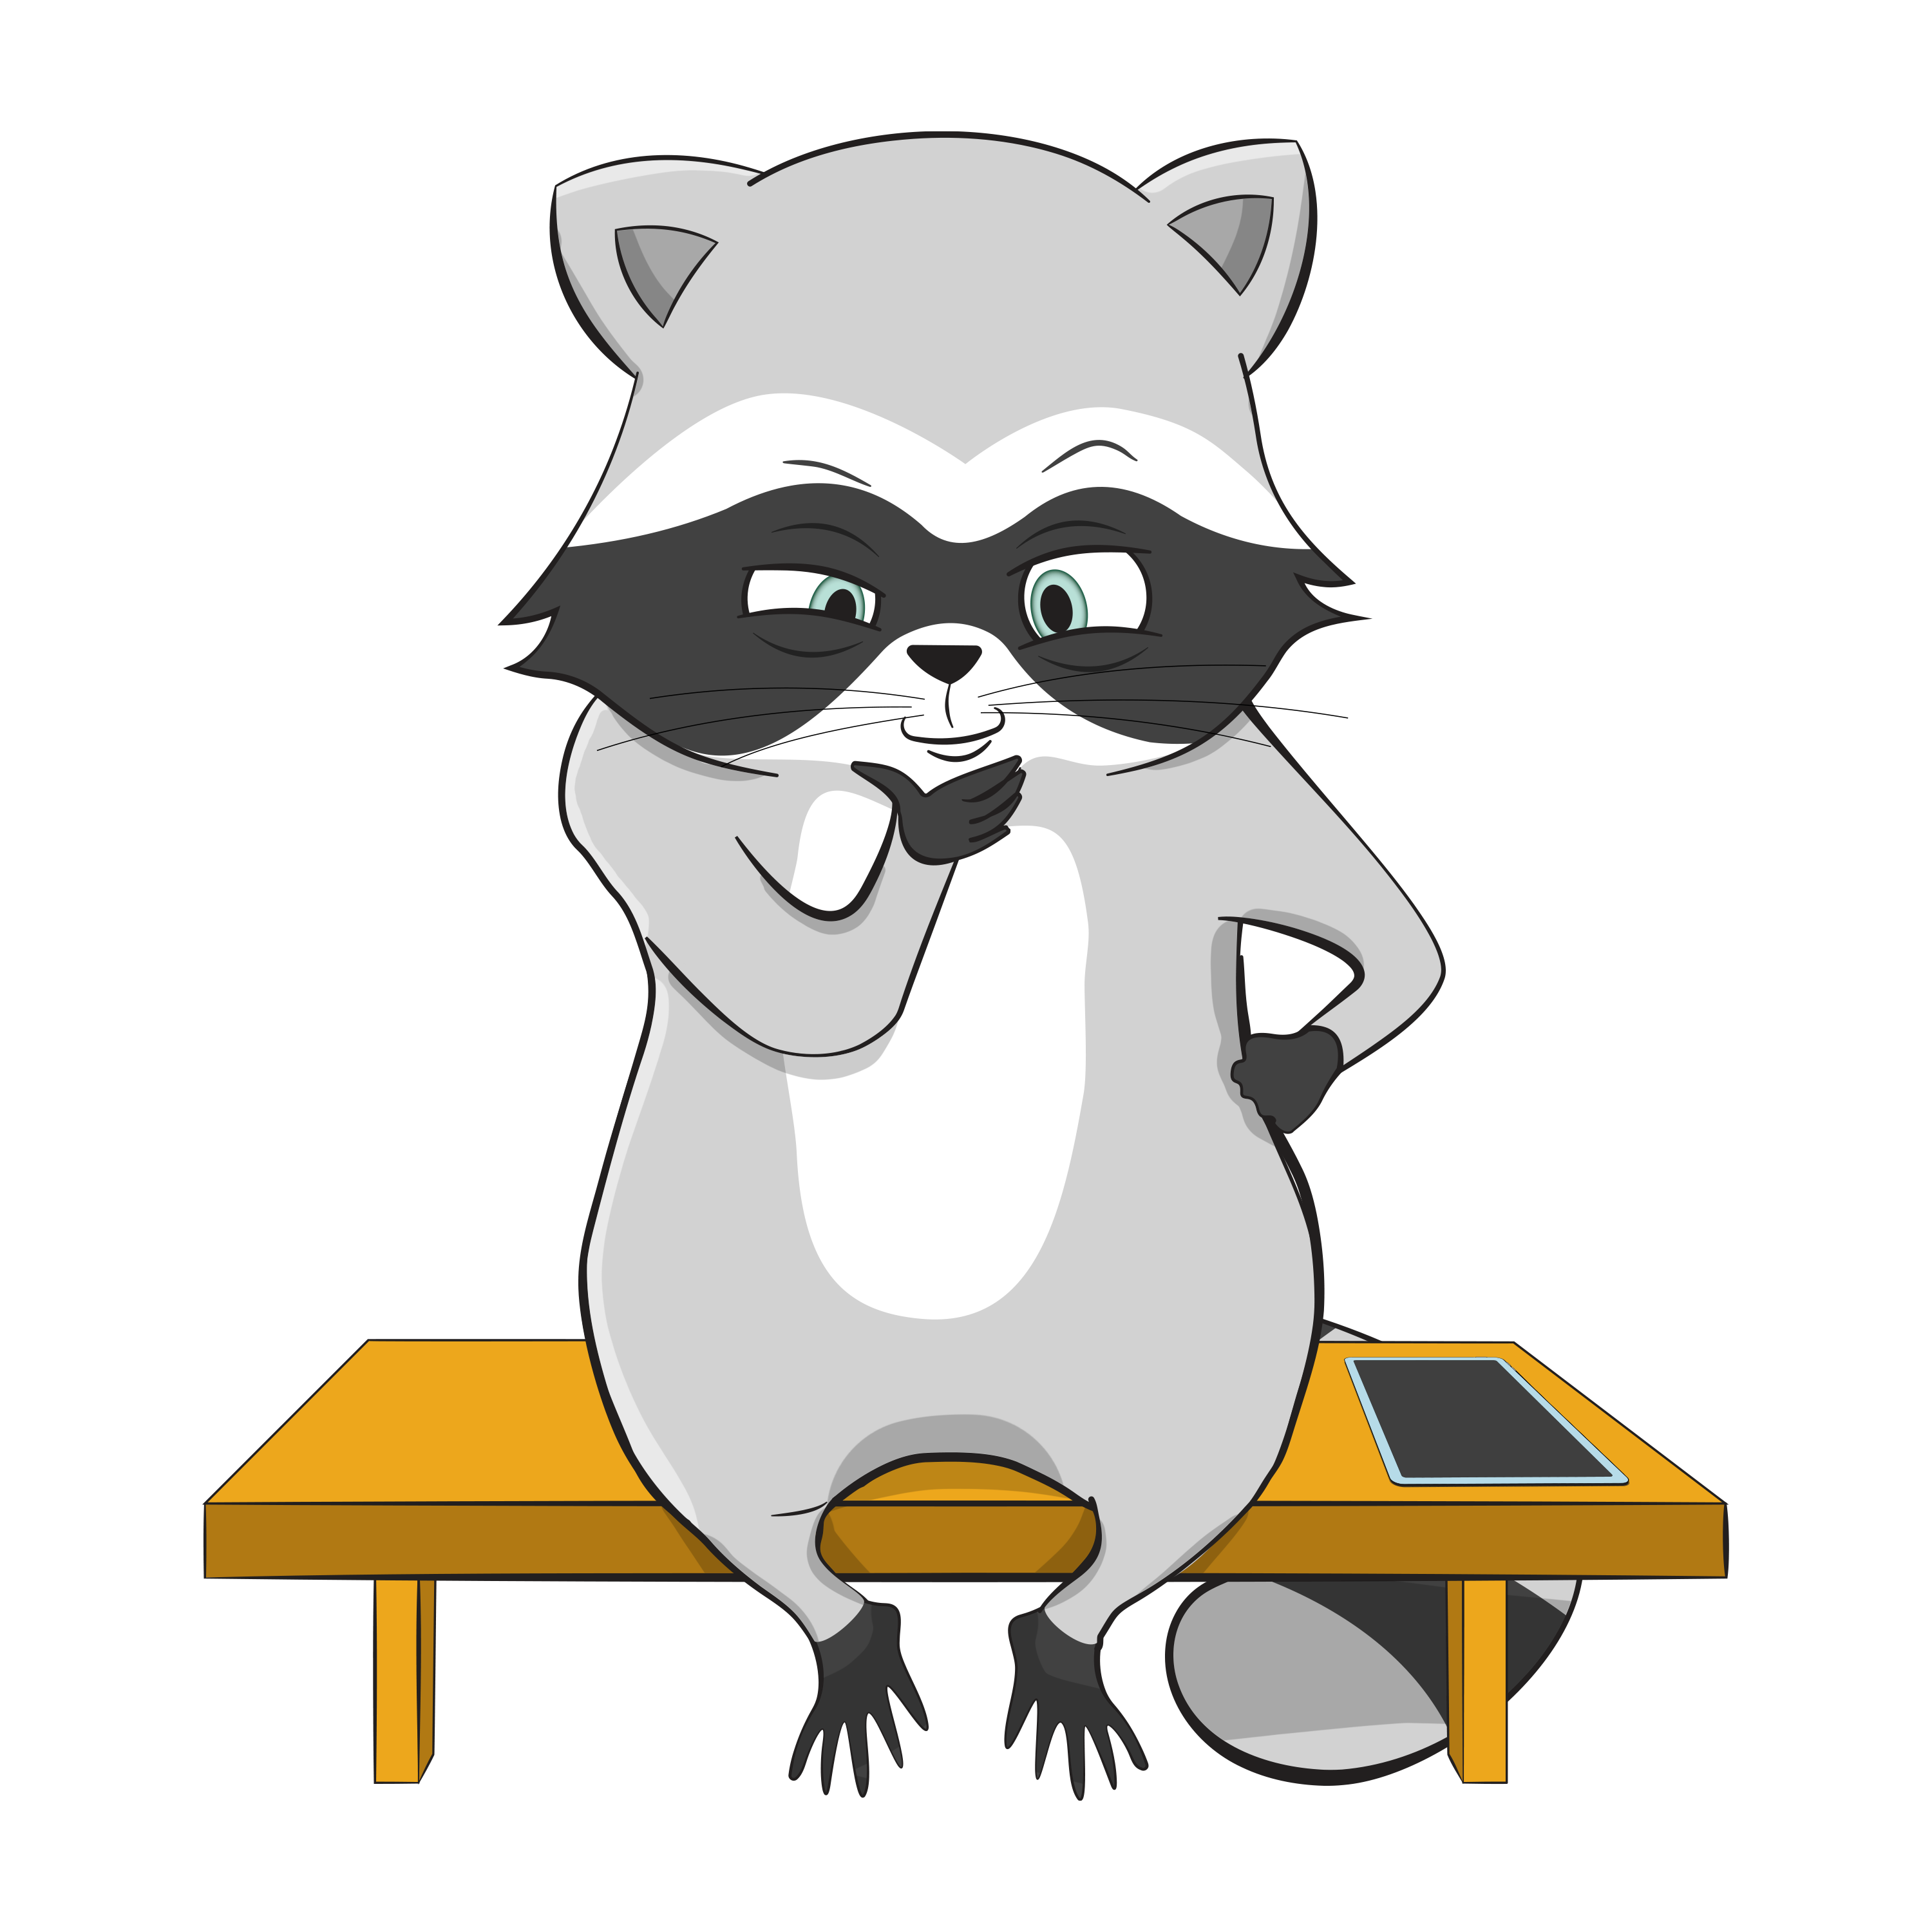
Discussion:
Self-Care & Your Device
How could these tools help with self-care?
Camera: Capture happy moments or things you want to remember
Clock: Reminders for medication or appointments
Calculator: Budget tracking
Maps: Find your way to new places safely
Is there anything else you can think of?

Slide 27
Things to Remember
Module One | Getting to Know Your Device
It’s All Good. You’ve Got This.
You can almost always undo something
You can almost always swipe back
You can always restart
!
Notes:
Technology is a tool to help you. You're learning to use it, and that takes time.

Slide 28
Today’s Achievements
Module One | Getting to Know Your Device
Today, you achieved the following:
Powered up a tablet
Used gestures like tap, swipe, and zoom
Recognized icons that work everywhere
Set an alarm
You did a lot today!
Let’s take a moment to recognize what you’ve accomplished in today’s module.
Notes:
Those are real skills you can be proud of!

Slide 29


Wrap-Up & Reflection
Module One | Getting to Know Your Device
What’s one thing you learned today that felt new or surprising?
What’s something you learned today that you want to practice more?
Remember: Learning technology
takes time. You’re doing great!

Slide 30

Looking Ahead
Module Two | Navigating the Internet
Next Week: The Internet!
See you April 2nd at 1:00!
Here is a look ahead at Module 2. We’ll learn:
How to type on the keyboard
How to connect to Wi-fi
How to search the internet
Notes:
You'll use the same icons you learned today - the magnifying glass for search, the gear for settings. See you then!

